Slide 1
Avaya Aura™ Midsize Enterprise
Pre-Beta Knowledge Transfer
Kirill Barannik
Global Market Introduction – Technical Enablement
28/02/2011

Slide 2
Agenda
KT Goals
ME Overview
Product Concept
Deployment
Maintenance
Components
Configuration
Installation
Challenges
Troubleshooting
Resources

Slide 3
KT Goal
What’s Covered
  Solution Overview of the Midsize Enterprise
  Installation Walk-Through
  Common Pitfalls
What’s not covered
  Technical Deep-Dive
  Endpoint Features not yet Approved for Alpha Trials
  Marketing and Sales for the Individual Products
  Design of Complex Customer Topologies
  Interoperation Scenarios outside the ME Scope
Notes:
3

Slide 4
ME vs CS – Nutshell level
CS = Collaboration Server , ME = Midsize Enterprise
(not CES and MES anymore)
CS + AES,SBC & CMM = ME
CS small 75 users, ME bigger 1000 users
Initially CS was targeted as a demo system for customers to “dip their toe in the water”
ME is a full production version of the above
  ME and CS incorporates CM-ES, not CM-FS. Use of sequenced applications in the half-call model is not tested and not supported.
Notes:
4

Slide 5
ME is big
CS is 7.6 GB
ME is 12.1 GB
Install via USB (16 GB recommended) for Beta or 3 single layer DVDs
Special copy feature on System Platform (SP 6.0.3)
Installation time about 3hr 30 min(about 30 minutes more than CS)
Notes:
5

Slide 6
Avaya Aura® Solution for Midsize Enterprise r6.1
Release Contents
Key Business Features for 6.1 release
  Virtualization: one-box SIP-based midsize enterprise solution using less rack space, greener
    Uses1 server-box vs. 7+ boxes separately deployed
  Less expensive than competitors, per user:
    15% (400 users) to 22% (1000 users) less than Cisco street price
  Includes Avaya Aura and an application suite, ready for basic collaboration
  Integrated Session Border Controller for embedded security for all SIP communication streams
  Designed to power the new Avaya Flare™ experience and video collaboration products
  Unified install, upgrade, remote support across all embedded applications allows for quicker and cheaper installs and faster maintenance
  Updates current Avaya MBT 5.2.1 solution to the latest Avaya Aura® 6.1 version

Slide 7
Avaya Aura® Solution for Midsize Enterprise (ME)
Key Specifications
Supported SIP Endpoints | Avaya Video Conference Solution components, Avaya Desktop Video Device (powered by the Avaya Flare™ Experience), SIP enabled phones
Virtualization | Avaya Aura® System Platform 6.0
Utility Services | Communication Manager Utility Services 6.1
Voice & Video Platform | Avaya Aura® Communication Manager and Communication Manager Messaging6.0.1
Session Management | Avaya Aura® Session Manager 6.1
Management | Avaya Aura® System Manager 6.1
Presence | Avaya Aura® Presence Services 6.0 (maybe 6.1)
AES | Avaya Aura® Application Enablement Services 6.1
SBC | Avaya Aura® Session Border Controller 6.0
# Users | 250 – 1000 users
# of locations | Target 10’s of locations, scales to 250 locations
Remote Access & Alarming | SAL (preferred) and VPN
Server Hardware | IBM S8800 and HP DL360G7

Slide 8
Target Use Cases
Use Cases | Avaya Aura® Solution for Midsize Enterprise (ME) R6.1
Stand Alone for Trials SIP 96XX all SIP 96X1 all Avaya one-X Communicator SIP Avaya Flare on the desktop video device (A175 Flare enabled unit) Avaya Video Conferencing Solution, then 1000 Series Video Endpoints | Yes Up to 1000 endpoints (100 video)
Stand Alone PBX | Yes
Migration: bolt on to CM 5.2.1 | Yes
Avaya Aura Contact Center | Yes
Migration Path for CS1K R6, R7, R7.5 (‘Bolt on’ integration testing with ME is planned) | Yes
Bolt on to CM 3.1.5 and CM 4.0.5 (integration testing with ME is planned) | Yes

Slide 9
ME Component LAN Connectivity
Product Concept – What is it?
System Platform
Session Manager 6.1
System Manager 6.1
Communication Manager (ES) 6.0.1
Presence Server 6.0
Utility Server 6.1
SBC 6.0
AE Server 6.1
Bridge/LAN
H.248 Media Gateway
A175/Flare Video Endpoint
AVCS Video Endpoint
Avaya one-X™ Communicator Video Endpoint
96XX/96X1 SIP Hardphone

Slide 10
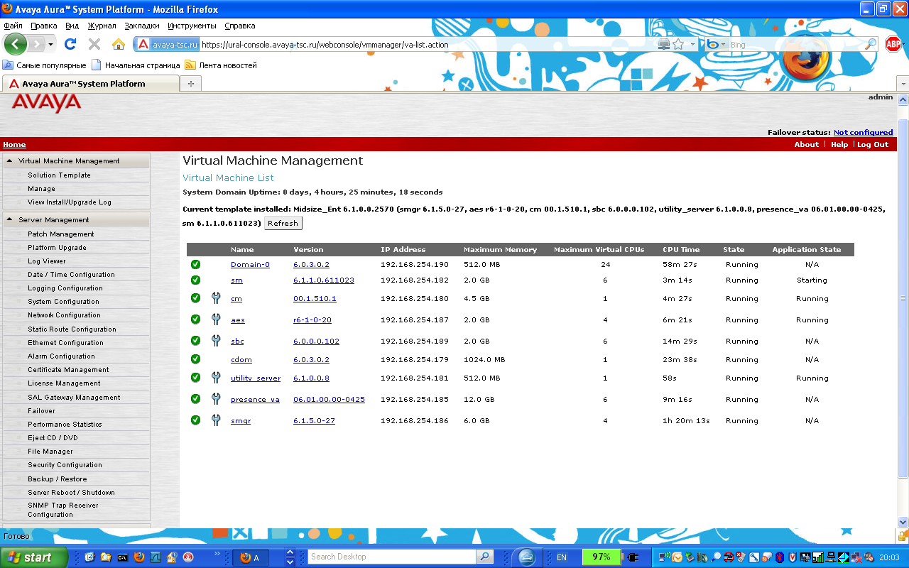
Product Concept – What is it?

Slide 11
Product Concept – What is it?
Endpoints - Avaya Video Collaboration Solution (AVCS)
  Avaya Rebranded LifeSize Units
  1010 – Fixed Camera, Video Codec, HD Monitor
  1020 – Pan/Tilt/Zoom Camera, Video Codec, HD Monitor
  1030 – PTZ Camera, Video Codec, dual HD Monitor
  1040 – PTZ Camera, Video Codec, dual HD Monitor, 4-Port Video Conference Bridge
  1050 – PTZ Camera, Video Codec, dual HD Monitor, 8-Port Video Conference Bridge

Slide 12
Endpoints (Continued)
Product Concept – What is it?
ADVD= “The Avaya Desktop Video Device (ADVD) with Flare User Experience.” (A175)
Avaya one-X™ Communicator 6.0
Avaya 96XX SIP Hardphones
Avaya 96X1 SIP Hardphones
Avaya Aura® Conferencing (MX6.0) Standard Edition

Slide 13
Deployment – How do we sell it?
Standard Ordering and Provisioning Processes
  The Customer or Partner orders the server, media-gateway, endpoints, and software.
  ME has standard Material Codes
  Standard License and Authentication Files
    SMGR’s WebLM is the license server
    Can run in no license mode for 30-day grace period
  Standard Product Registration

Slide 14
Maintenance – How do we support it?
All ME systems are configured to use SAL
  All individual Virtual Machine products in the ME template implement remote access and alarming via standard configuration.
Documentation is streamlined
  Standard installation, administration guides, and Intelligent Workbook are available on http://support.avaya.com.
  Additional job aids, notes, procedures, and presentation recordings are posted on the GMI Portal.
Standard escalation procedures

Slide 15
Components – What do you get?
S8800 Server 1U – Collaboration (Material Code 262641)
  Dual Quad-Core x5570 2.93GHz CPUs
  32GB RAM (16-2GB DIMMs, COMCODE 700478274)
  Six 146GB SAS Hard Disk Drives, (COMCODE 700478316) RAID5 (680GB)
  Dual Power Supplies (COMCODE 700478308)
  Six Ethernet Ports
    2 – NICs on Main Board
    2 – NICs on Daughterboard (COMCODE 700478282)
    2 – NICs on PCI Riser (COMCODE 700478290)
  1.75 Amps at 117VAC

Slide 16
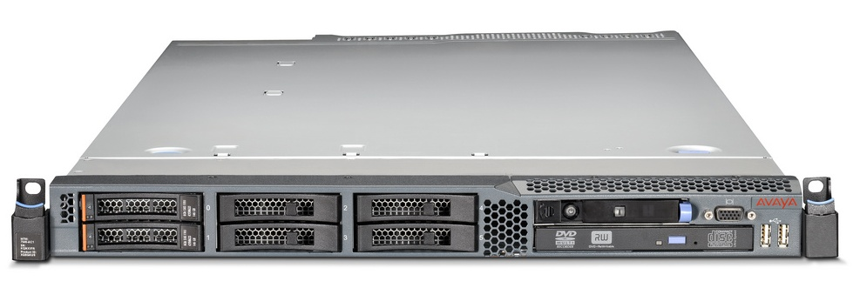

Components – What do you get?
S8800 Front Panel

Slide 17
Components – What do you get?
S8800 Rear Panel

Slide 18
Components – What do you get?
HP DL360G7 SRVR 2CPU HI1 – Collaboration (Material Code 263762, COMCODE 700501088)
  Dual 6-Core x5670 2.93GHz CPUs
  48GB RAM (12-4GB DIMMs, COMCODE 700501319)
  Four 300GB SAS Hard Disk Drives, (COMCODE 700501314) RAID5 (838GB usable)
  Dual 750 Watt Power Supplies (COMCODE 700501312)
  Eight Ethernet Ports
    4 – NICs on Main Board
    4 – NICs on PCI Riser (COMCODE 700501322)

Slide 19
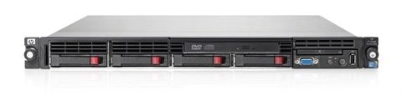
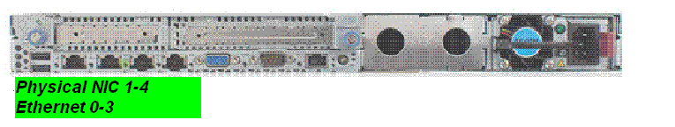
Components – What do you get?
HP DL360G7
eth0 Corp.LAN
eth1 Services

Slide 20
Components – What do you get?
H.248 Media-Gateway
  Required for Media Services
  Can be G250, G350, G450, or G430
  No MM Media Modules required
Software
  System Platform 6.0.3.0.2
  ME Template Midsize_Ent 6.1.0.0.2570 Software (12GB)
  Latest Updates (Patches) for System Platform and VMs
  Latest Updates for AVCS, ADVD, Avaya one-X™ Communicator, 96XX/96X1 SIP Hardphones, G430 MG

Slide 21
Hardware Platforms – S8800 IBM & HP ProLiant
 | S8800 | HP DL360G7
Material Code | 262641 | 263762
Rack Size | 1U | 1U
CPUs | 2 | 2
Cores per CPU | 4 | 6
Memory, RAM | 32 GB | 48GB
Hard Drives | 146 GB * 6 = ~670GB useable | 300 GB * 4 = ~820GB useable
RAID Level | 5 | 5
Power Supply | 2 | 2
NICs available | 6: MB 2 port + (two) PCI 2 port | 8: MB 4 port + (two) PCI 2 port
NIC connections
  Corporate ethernet NIC (eth0 or LAN connector 1) for avpublic
  LAN connector 2 (eth1) is used as a services port.
  The additional NICs are required for AES and SBC.

Slide 22
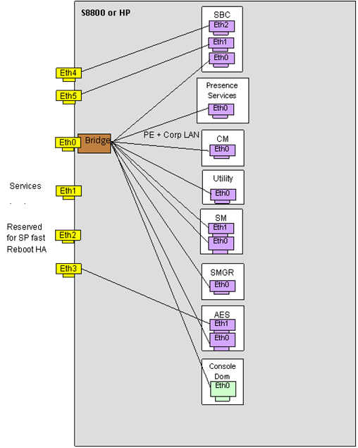
Ethernet Port allocation

Slide 23
Installation – Before you start
WinSCP, Putty, md5sum
Standalone Installation wizard (SP_Pre-Installation_Wizard_5470.exe), ABIT
SP, ME Template disk images
Patches (SP, CM/CMM, AES, PS, SMGR, SM, SBC)
H.248 firmware

Slide 24
Installation – How do you install and configure?
Fill out Configuration Data Worksheet in ME Intelligent Workbook
Run the standalone Installation Wizard to generate the EPW file.
Install ME Server and Media-Gateway in Rack, connect Power, LAN
Configure Media-Gateway
Install System Platform 6.0.3.0.2 software and update (30 minutes)
Configure SAL and register the system
Install ME template (2 - 4 hours)
Apply latest VM updates (CM, SMGR, Presence Server, AES)
Configure SMGR, Presence Server, Endpoints (1 hour)
Install License and Authentication Files (10 minutes)
Connect Endpoints and verify calls

Slide 25
ME Topology – System Platform Installation
DOM-0 (Xen Hypervisor)
Console
Domain
LAN
Install System Platform on ME Server, configure networking:
DOM-0 IP Address and FQDN (not just hostname!)
CDOM IP Address and FQDN (not just hostname!)
Subnet Mask
Primary and Secondary DNS Server IP Addresses
Default Gateway (router)
IPV4 Forwarding Enabled
Time Zone, Date/Time, NTP Server IP Address
Default Login Passwords (root, admin, cust, LDAP)
25
Notes:
25
Before you start verify Dom0 and Cdom IP addresses are not present in the network!

Slide 26
ME Topology – SAL Configuration
DOM-0 (Xen Hypervisor)
Console
Domain
SAL
LAN
Configure Secure Access Link for Remote Access and Alarming:
Login on CDOM via browser session
Configure and test remote access to the ME server
See the following document for instructions:
  “Job Aid: Administering Remote Access and Alarming for Avaya Aura® Collaboration Server (CS) 6.1 Using Secure Access Link (SAL)”
    https://support.avaya.com/css/P8/documents/100124786
26
Notes:
26

Slide 27
ME Topology – Template Installation
DOM-0 (Xen Hypervisor)
Console
Domain
CM
SM
System
Manager
Presence
Server
Utility
Server
LAN
Admin Installs ME Template from CDOM Browser Session:
Admin selects the ME Template to install, specifying USB, DVD , PLDS
Template Installer copies VM images onto hard drive from USB, DVD or PLDS
Template Installer creates web application, launches ME Installation Wizard
ME Installation Wizard loads EPW or collects configuration data from user
ME Installation Wizard generates XML files for later use in SMGR configuration
Template Installer assigns resources, sets up networking for VMs
Template Installer installs the individual VMs, restarts VMs and networking
Template Installer launches the Post-Install Plug-in
27
Notes:
27

Slide 28
ME Topology – Post-Install Plug-in Execution
DOM-0 (Xen Hypervisor)
Console
Domain
CM-ES
SM
System
Manager
Presence
Server
Utility
Server
MG
Registers
Certificate
Exchange
LAN
Template Installer executes Post Install Plug-in:
Automatically applies VM Patches (SMGR, Presence)
Sets Enrollment Password in SM & SMGR (Certificate Exchange)
Configures non-root user in SMGR (used for CLI login)
Modifies VM hosts and DNS configuration files as necessary
Configures Presence Server, Utility Server
Configures CM as CM-ES and administers all CM features
G430 Media Gateway registers with CM-ES
Template Installation completes
G430
MG
28
Notes:
28

Slide 29
ME Topology – Apply Recent Software Updates
DOM-0 (Xen Hypervisor)
Console
Domain
CM-ES
SM
System
Manager
Presence
Server
Utility
Server
LAN
Apply Patches to VMs and Update G430 Software:
Download latest GA patches for CM, SMGR, and Presence Server
Apply CM patch using CDOM Patch Management feature
Apply SMGR patch (.bin file) using Release Notes instructions
Apply Presence server patch using Release Notes instructions
Download latest G430 Software Update
Update G430 Software
G430
MG
29
Notes:
29

Slide 30
ME Topology – SMGR Manual Configuration
DOM-0 (Xen Hypervisor)
DRS
Console
Domain
CM-ES
SM
System
Manager
Presence
Server
Utility
Server
SIP Trunk
SIP Entity
Link
SIP Entity
Link
LAN
Admin Completes Manual Configuration in SMGR:
Admin imports XML files generated by ME Installation Wizard
Admin adds SM as a Managed Element in SMGR
SMGR replicates data to SM via Data Replication Service (DRS)
SM brings up Asset (aka Security Module, SM100) SIP interface
Admin confirms that SM SIP Entity links to CM-ES, Presence are up
Admin changes SM Service State to Accepting New SIP Requests
SM-to-CM-ES SIP Trunk (Trunk Group 3) comes into service
Admin makes CM-ES the Sequenced Application for SM
G430
MG
30
Notes:
30

Slide 31
ME Topology – License and Authentication Files
DOM-0 (Xen Hypervisor)
Console
Domain
CM-ES
SM
System
Manager
Presence
Server
Utility
Server
LAN
Install License and Authentication Files:
Get SMGR primary MAC address from SMGR WebLM GUI
Generate and download License and Authentication Files in PLDS
Install License files using SMGR WebLM GUI
Install Authentication file using System Platform (CDOM) GUI
Confirm license status in CM-ES
Note: All features work in no-license mode for 30 day grace period
G430
MG
31
Notes:
31

Slide 32
ME Topology – Presence Server Configuration
DOM-0 (Xen Hypervisor)
Console
Domain
CM-ES
SM
System
Manager
Presence
Server
Utility
Server
LAN
Use SMGR to configure Presence Server:
Access Presence Server via browser and confirm server health
Use SMGR to set the Presence Domain-From value
Use SMGR to set the Presence Domain-To value
Set the Presence Access Control List default to Allow
Restart the Presence Server to activate the Domain changes
G430
MG
32
Notes:
32

Slide 33
ME Topology – Administer New Flare/A175 User
DOM-0 (Xen Hypervisor)
Console
Domain
CM-ES
SM
System
Manager
Presence
Server
Utility
Server
LAN
Add a new Flare/A175 user:
Use SMGR Manage User feature to add user
  Configure User Identity
  Configure Communication Profile
  Configure Membership Roles
  Add Contacts (Including Presence Buddies)
SMGR then adds new user to SM, PS databases
SMGR then logs into CM-ES, adds station
Don’t forget to save translations in CM-ES !!!
G430
MG
Flare/A175
Endpoint
33
Notes:
33

Slide 34
ME Topology – Manual Flare/A175 Setup
DOM-0 (Xen Hypervisor)
Console
Domain
CM-ES
SM
System
Manager
Presence
Server
Utility
Server
LAN
Manually Configure Flare/A175
Fileserver IP Address
Endpoint Group
SIP Domain
TLS/Port 5061
Login Name
Login Password
G430
MG
Flare/A175
Endpoint
34
Notes:
34

Slide 35
ME Topology – Flare/A175 DHCP Addressing
DOM-0 (Xen Hypervisor)
Console
Domain
CM-ES
SM
System
Manager
Presence
Server
Utility
Server
LAN
Connect Flare/A175 to the LAN:
Acquires from DHCP Server:
  IP Address
  SIP Registrar IP Address (SM Asset)
  Protocol/Port (TLS/5061)
  Fileserver IP Address
G430
MG
Flare/A175
Endpoint
35
Notes:
35

Slide 36
ME Topology – Flare/A175 Software Upgrade
DOM-0 (Xen Hypervisor)
Console
Domain
CM-ES
SM
System
Manager
Presence
Server
Utility
Server
LAN
Flare/A175 Contacts Fileserver:
Acquires Files:
  Axxxupgrade.txt
  Axxxsettings.txt
  Software Upgrade Tarfile
Upgrades Software
Reboots
G430
MG
Flare/A175
Endpoint
36
Notes:
36

Slide 37
ME Topology – Flare/A175 Registration with SM
DOM-0 (Xen Hypervisor)
Console
Domain
CM-ES
SM
System
Manager
Presence
Server
Utility
Server
LAN
Flare/A175 Registers with SM:
Reconnects to LAN
Prompts User for Username/Password
Sends Registration Request to SM Asset
SM Authenticates User-Entered Password
Endpoint is Registered, Can Make Calls
G430
MG
Flare/A175
Endpoint
37
Notes:
37

Slide 38
ME Topology – Add Other Endpoint Types
DOM-0 (Xen Hypervisor)
Console
Domain
CM-ES
SM
System
Manager
Presence
Server
Utility
Server
LAN
G430
MG
Flare/A175
Endpoint
AVCS
Endpoint
96X1/96XX
Endpoint
Avaya one-X™
Communicator
Administer, Set up, and Connect other Endpoints
All Acquire IP address, SIP Registrar IP Address from Utility Server
96X1/96XX Endpoints Update Their Software Automatically
All Endpoints Register with the SM Asset
38
Notes:
38

Slide 39
Intelligent Workbook
  The ME Intelligent Workbook is a Microsoft Excel 2003 or 2007 Spreadsheet with multiple worksheets.
  Download the ME Intelligent Workbook from support.avaya.com or the GMI Portal.
  All cells are protected except the customer system’s values column on the Configuration Data worksheet.
  Values entered on the Configuration Data worksheet populate cells throughout the workbook as those values are referenced by the procedures. Those values appear in bold green font, to distinguish them from non-user-set values.
  Each ME Intelligent Workbook is tied to a specific ME template, since the software versions specified in the workbook change from template to template.

Slide 40
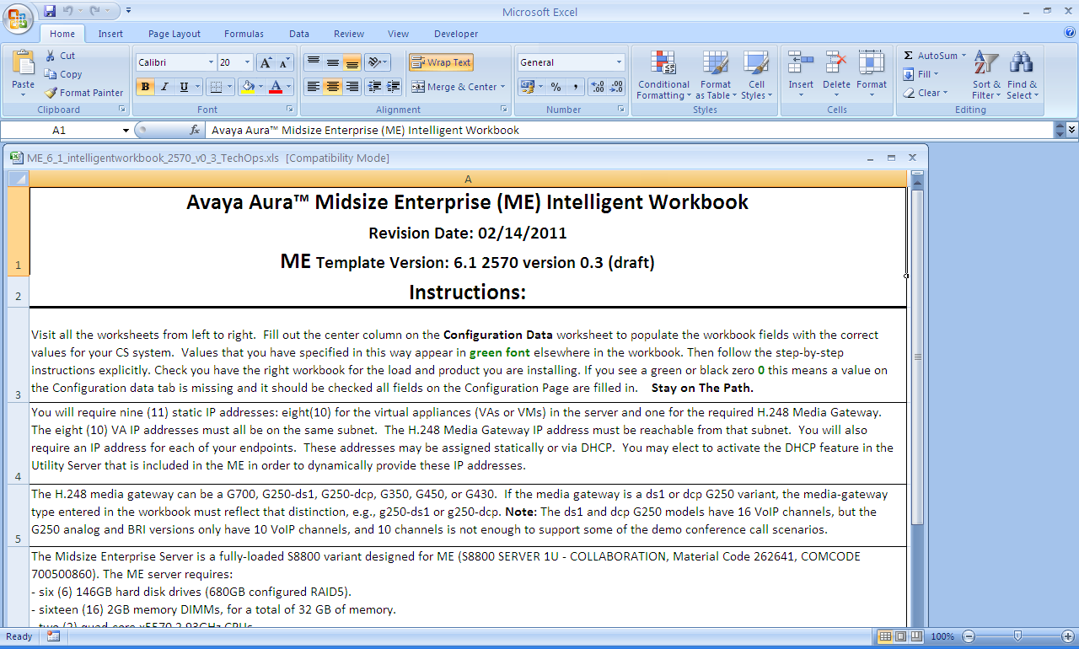
Intelligent Workbook
Instructions Worksheet

Slide 41
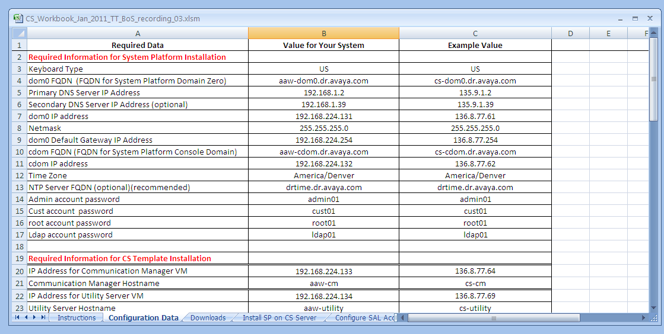
Intelligent Workbook
Configuration Data Worksheet
Only Column B, “Value for Your System”, is Writeable

Slide 42
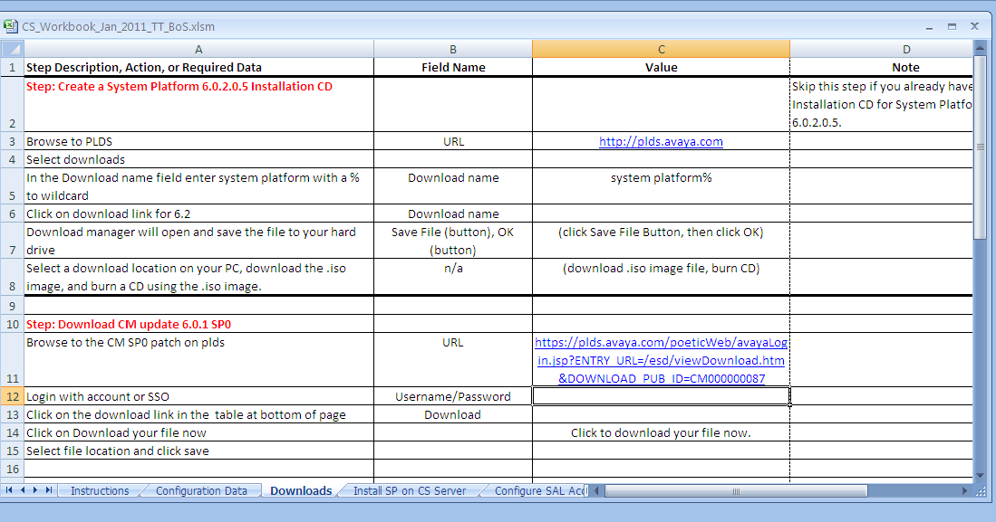
Intelligent Workbook
Downloads Worksheet
URL for Software Repository

Slide 43
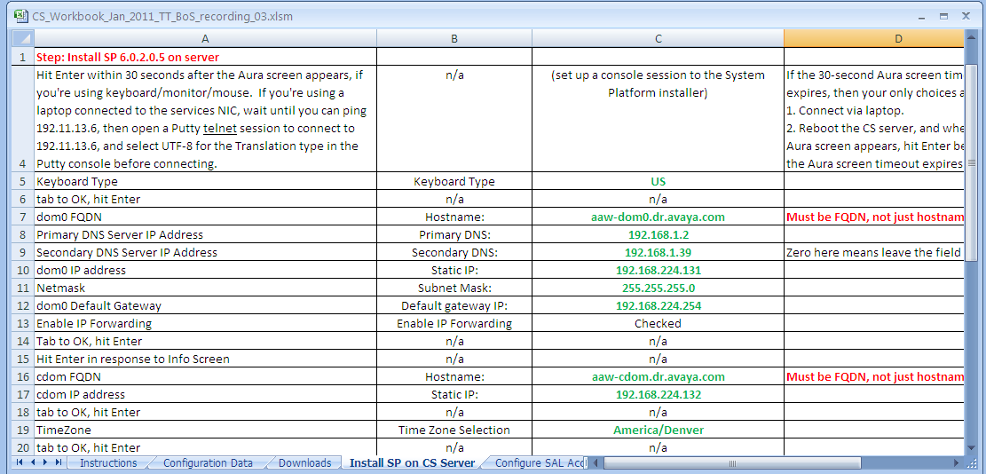
Intelligent Workbook
Install SP Worksheet
Configuration Data Sheet values appear in bold green font

Slide 44
Intelligent Workbook - Worksheets
Instructions
Configuration Data
Downloads
  Create a System Platform 6.0.3.0.2 Installation CD
  Download VM software updates for CM, SMGR, and Presence Server
Install System Platform Software on ME Server
Configure SAL Access
Install ME Template
  Confirm that all VM IP addresses are currently unused
  Install ME template
Apply Application Patches
  Apply latest CM service pack to the CM VM
  Apply latest SMGR patch to the SMGR VM
  Apply latest Presence Server patch to the Presence Server VM

Slide 45
Intelligent Workbook - Worksheets
Configure System Manager
  Logon to System Manager and set password
  Import System Manager XML
  Create Session Manager Instance
  Confirm that Session Manager Instance Tests Pass
  Confirm or Repair SMGR-SM Data Replication Service Status
  Add CM-ES as a Sequenced Application
  Create Application Sequence
License the System (PLDS)
  Redirect CM to SMGR WebLM Server for Licensing
  Retrieve license file(s) from PLDS
  Install license file(s) on the SMGR WebLM Server
  Retrieve authentication file from PLDS
  Install Authentication File on System Platform

Slide 46
Intelligent Workbook - Worksheets
Configure CM-ES
  No manual configuration required
  Confirm that CM-ES-to-SM SIP Trunk is in service
Configure Presence
  Login to Presence
  Login to SMGR
  Configure Presence Domain-From and Domain-To values
  Set default Access Control List (ACL)
Import ABIT users (optional)
Configure Avaya Video Collaboration Solution (AVCS) User
  Open User Management SMGR page, Select New User
  Complete Identity Section
  Complete Communication Profile Section
  Complete Membership Roles Section
  Complete Contacts Section, Commit the Form
  Save Translations

Slide 47
Intelligent Workbook - Worksheets
Configure Flare/A175 User
  Open User Management SMGR page, Select New User
  Complete Identity Section
  Complete Communication Profile Section
  Complete Membership Roles Section
  Complete Contacts Section, Commit the Form
  Save Translations
Configure Avaya one-X™ Communicator SIP User
  Open User Management SMGR page, Select New User
  Complete Identity Section
  Complete Communication Profile Section
  Complete Membership Roles Section
  Complete Contacts Section, Commit the Form
  Save Translations

Slide 48
Installation - Installation Wizard
Two Operating Modes:
  Stand-alone (PC .exe package)
  Embedded in ME Template (Runs as part of Template Install)
Configures and automatically integrates ME component applications.
Easy-to-use interface allows fast and accurate system configuration.
Installation Wizard generates Configuration XML files for import directly into System Manager, avoids much manual administration.
Architecture of installation wizard allows gathering of administration & configuration data before server is on-site = standalone installation wizard
  Run on a PC prior to any Avaya server hardware being on-site
  Generates an epw.zip file for import when ME installation begins
  Provides load/save options to allow incremental configuration

Slide 49
Functionality Provided by ME Installation Wizard
  Installs the various applications
    Network settings for applications
    Administers user -defined customer login accounts on VMs
Generates XML files to configure SMGR
    SIP Domain, Location, SM-CM, SM-PS, SM-CMM, SIP entities and entity links
  Configures CM
    Configures settings to enable video and other needed features
    Telephony settings set to country specific values (e.g. 9 or 0 for external calls), basic IP services, network-regions, etc.
    46xxsettings file included with Utility Services and basic DHCP setup
    Trunk & gateway configuration added to CM
    Configures H.248 Media Gateway
    Configures CM end of SM –to-CM SIP Trunk

Slide 50
Installation – Step 1
Fill out Configuration Data Worksheet in ME Intelligent Workbook
Run the standalone Installation Wizard to generate the EPW file.
Install ME Server and Media-Gateway in Rack, connect Power, LAN
Configure Media-Gateway
Install System Platform 6.0.3.0.2 software and update (30 minutes)
Configure SAL and register the system
Install ME template (2 - 4 hours)
Apply latest VM updates (CM, SMGR, Presence Server)
Configure SMGR, Presence Server, Endpoints (1 hour)
Install License and Authentication Files (10 minutes)
Connect Endpoints and verify calls

Slide 51
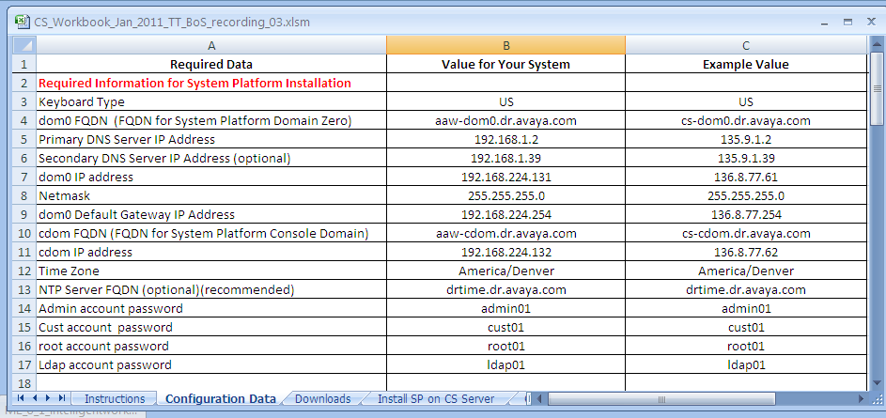
Configuration Data Worksheet
Data Values required for System Platform Install
(See additional off-slide notes below)
Notes:
Notes:
Line 4: Provide FQDN, not just hostname. The System Platform installer extracts the DNS domain name (dr.avaya.com in this case) from the value you provide. If you provide only the hostname, the DNS domain name is never set for System Platform.
Line 13: We recommend the use of NTP, in order to make log timestamps more usable and relevant to real time.
Lines 14-17: The default passwords are shown. You can accept the defaults, or you can create your own passwords for these System Platform accounts.
Lines 5-6: DNS Primary and Secondary IP Addresses are optional. However, if you put nothing in these fields, then you’ll see a zero (0) appear in the relevant field later in the workbook. When this happens, do not enter the zero (0) in the administration interface. Just leave that field blank and proceed to the next field.

Slide 52
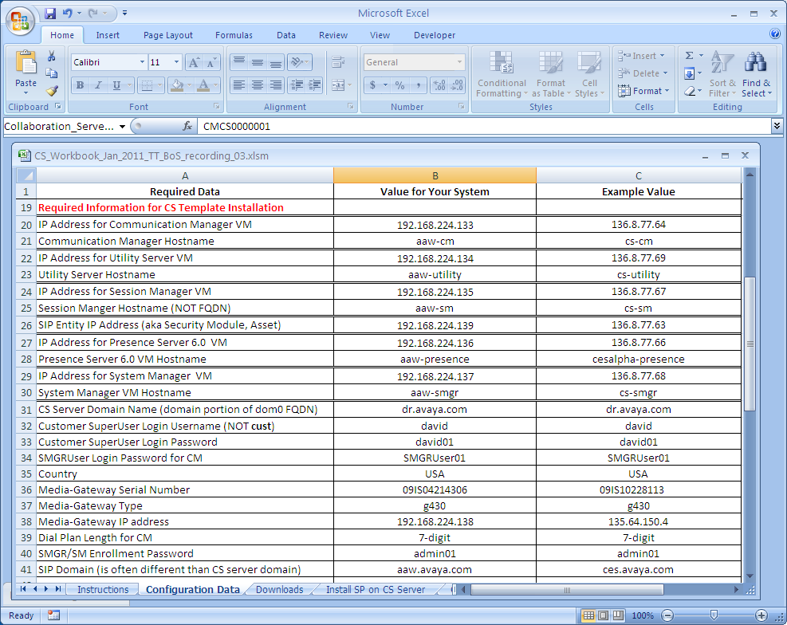
Configuration Data Worksheet
Data Values required for ME6.1 Template Install
(See additional off-slide notes below)
Notes:
Notes:
Lines 20-30: These are paired values (IP address/hostname) for the VMs in the template, i.e., CM, Utility Server, Session Manager, Presence Server, and System Manager.
Line 26: The Session Manager VM has a second interface called the “SIP Entity”. This interface has no hostname, only an IP address. SIP Servers and Endpoints use this interface for registration and other SIP messaging.
Line 35: The ME Server Domain is the DNS domain that you provided as part of the dom0 and cdom “hostnames” (FQDNs, really) during the System Platform installation.
Lines 36-37: The customer super-user login is the CM login that you’ll use to access CM most often. It is set up by the Installation Wizard as a profile 18 superuser login, and has sufficient permissions to perform all your installation tasks for CM.
Line 38: The SMGRUser login is defined by the system, but you select its password. System Manager uses this account to access CM and run necessary administration commands (like add station, save trans, etc.) on your behalf.
Lines 46-47: Be careful to accurately specify the media-gateway type and serial number. If you get this wrong, the SIP trunk between SM and CM will not come into service, and your endpoints will not be able to make calls. If you discover later that you made an error here, you can correct it in CM by removing and then adding back the media-gateway, using the correct information.
Line 48: The Media Gateway IP Address is entered here for reference only. The Installation Wizard cannot configure the Media Gateway initial networking parameters: you must do that manually using the standard installation and administration instructions for Avaya H.248 media gateways.
Line 40: Dial Plan length can be 3, 4, 5, 6, or 7. The Installation Wizard will use the value that you select to build a standard dial plan that corresponds to that length in CM.
Line 41: The Installation Wizard provides the enrollment password to both SM and SMGR, and sets the expiration timer to one (1) hour. SM presents the enrollment password to SMGR in order to first establish contact, and if it matches SMGR’s copy, then SMGR and SM exchange certificates for the TLS link that will connect them, using the Secure Certificate Exchange Protocol (SCEP). This strategy reduces that certificate exchange (which can otherwise be complicated and time-consuming) to an automatic, invisible transaction. Because the enrollment password expires in one hour, if you later need to configure additional SIP server entities in the system, then you must reset the enrollment password in SMGR and set a new expiration timer value. The navigational path to that page in SMGR is Services -> Security -> Certificates -> Enrollment Password. The expiration timer can take on values between one hour and four weeks.
Line 42: The SIP Domain groups your SIP entities (servers, endpoints) into a community for authentication and service purposes. In order to register with your Session Manager and use it to make calls, an endpoint must be in the proper SIP domain, or Session Manager will refuse service. The SIP Domain is an entirely different thing than the ME server’s DNS domain, which groups system platform and the included Virtual Machines for the purposes of translating their hostnames into IP addresses (and vice-versa). In this workbook example, the DNS domain is dr.avaya.com, while the SIP Domain is aaw.avaya.com.

Slide 53
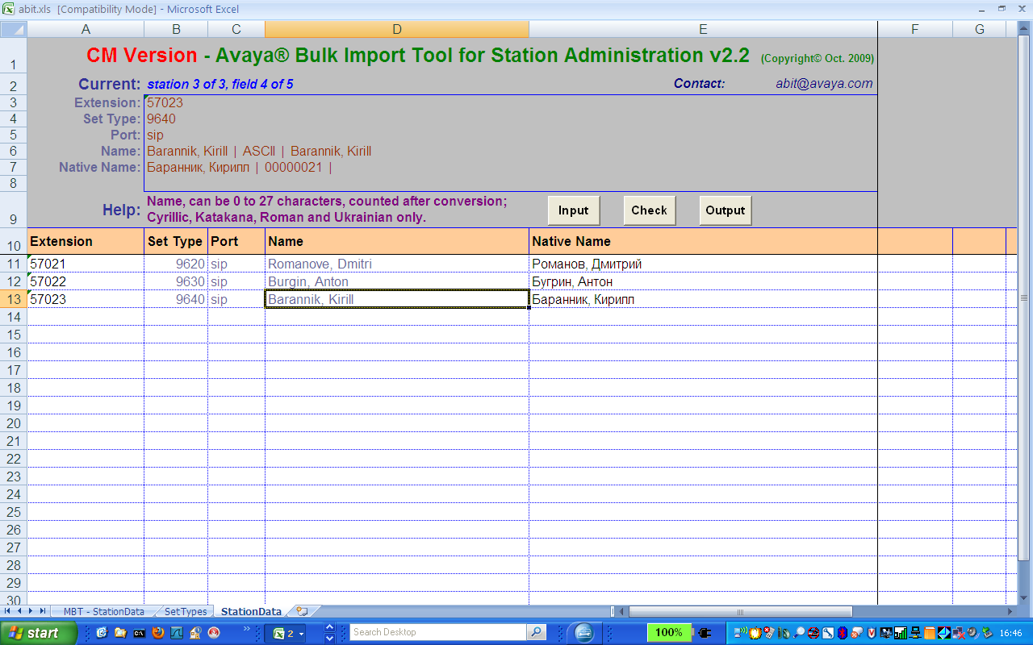
ABIT – Input Station Data

Slide 54
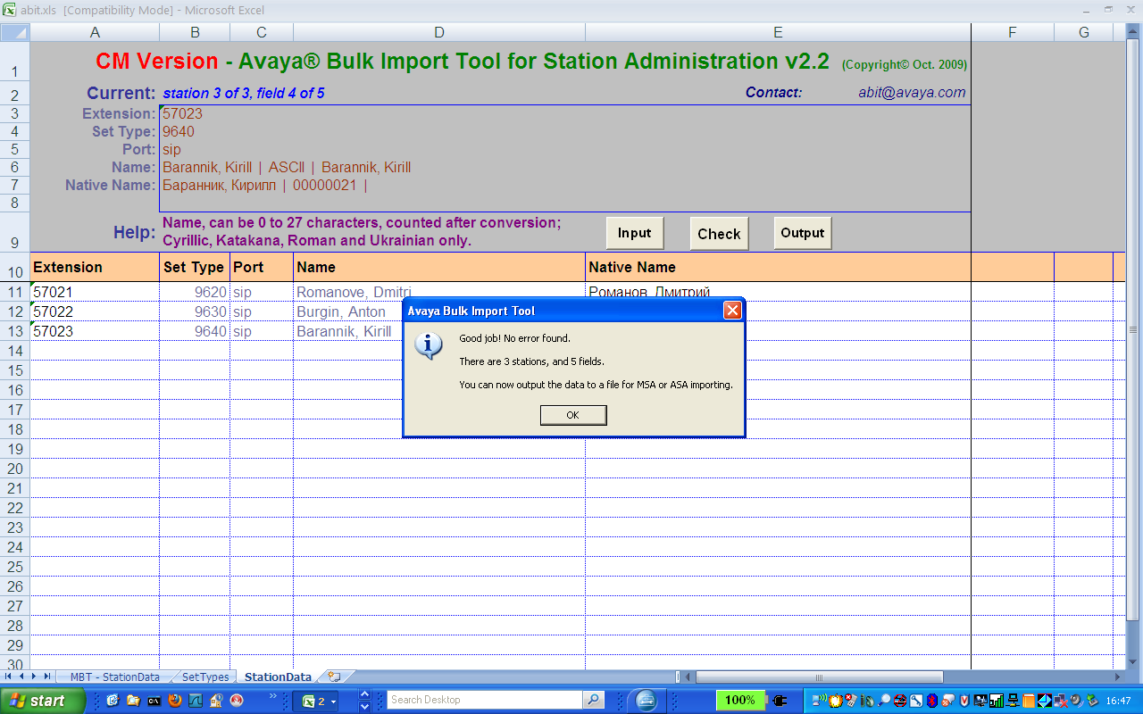
ABIT – Check station data
Click “Check” button when finished station data input

Slide 55
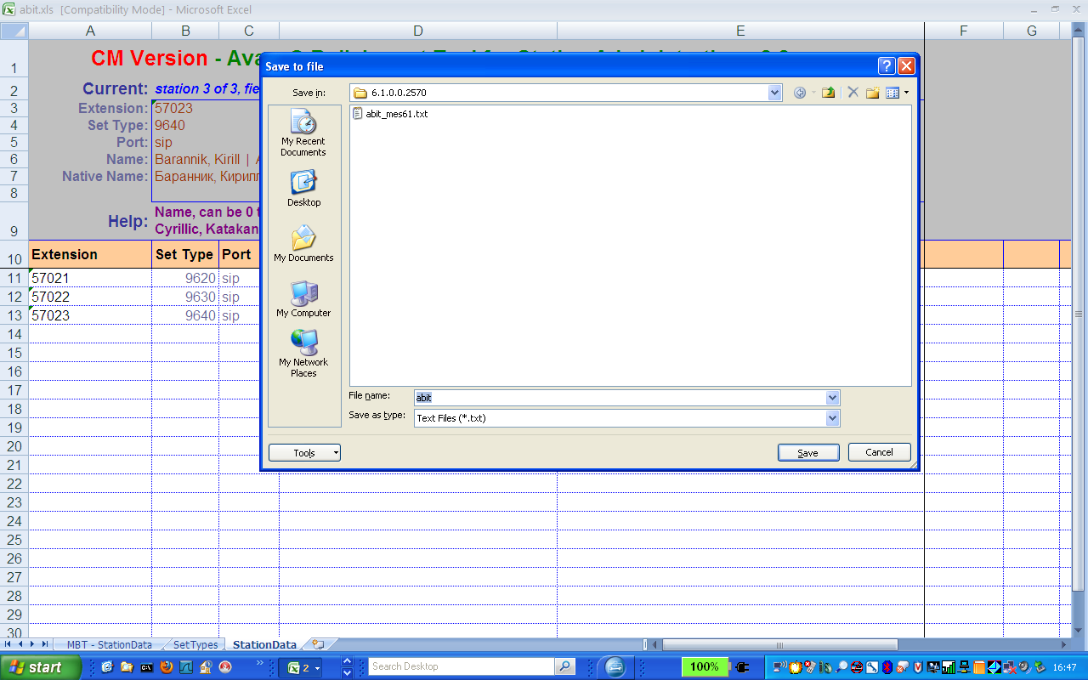
ABIT – Save abit.txt file

Slide 56
Installation – Step 2
Fill out Configuration Data Worksheet in ME Intelligent Workbook
Run the standalone Installation Wizard to generate the EPW file.
Install ME Server and Media-Gateway in Rack, connect Power, LAN
Configure Media-Gateway
Install System Platform 6.0.3.0.2 software and update (30 minutes)
Configure SAL and register the system
Install ME template (2 - 4 hours)
Apply latest VM updates (CM, SMGR, Presence Server)
Configure SMGR, Presence Server, Endpoints (1 hour)
Install License and Authentication Files (10 minutes)
Connect Endpoints and verify calls

Slide 57
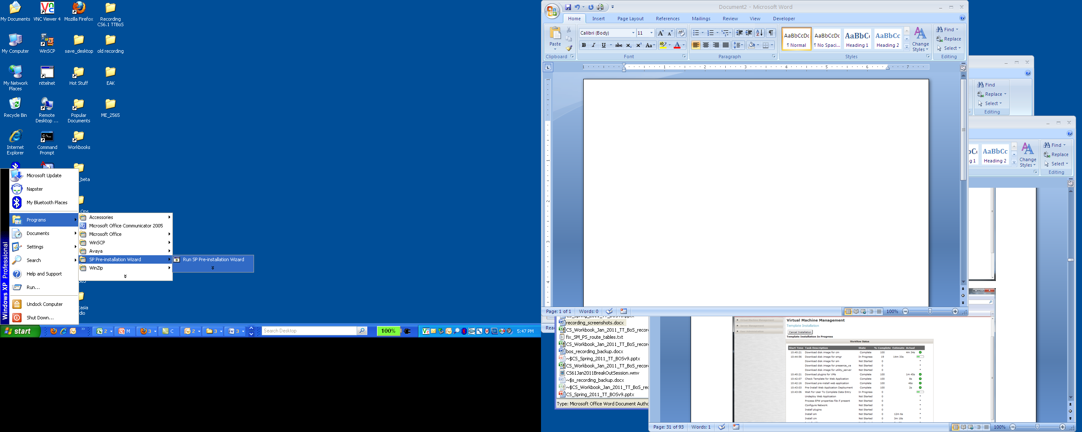
ME Installation Wizard
Launching the Standalone Installation Wizard
Notes:
This slide shows a PC on which the Standalone Installation Wizard has already been downloaded and installed.
The Standalone Installation Wizard is a .exe file that self-installs on your PC when you double-click the .exe file.
When the installation is complete, you launch the Standalone Installation Wizard by accessing it from the Windows Start menu, as shown.

Slide 58
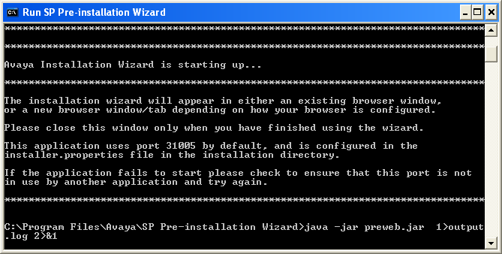
ME Installation Wizard
Launching the Standalone Installation Wizard
Notes:
Double-clicking the SP Pre-Installation Wizard link launches a Windows command window.
Note the background command at the bottom of the window: this command launches the Wizard in its own window.
The Command window persists, even when the Wizard’s window is later killed. You must delete this window manually when you’ve finished.

Slide 59
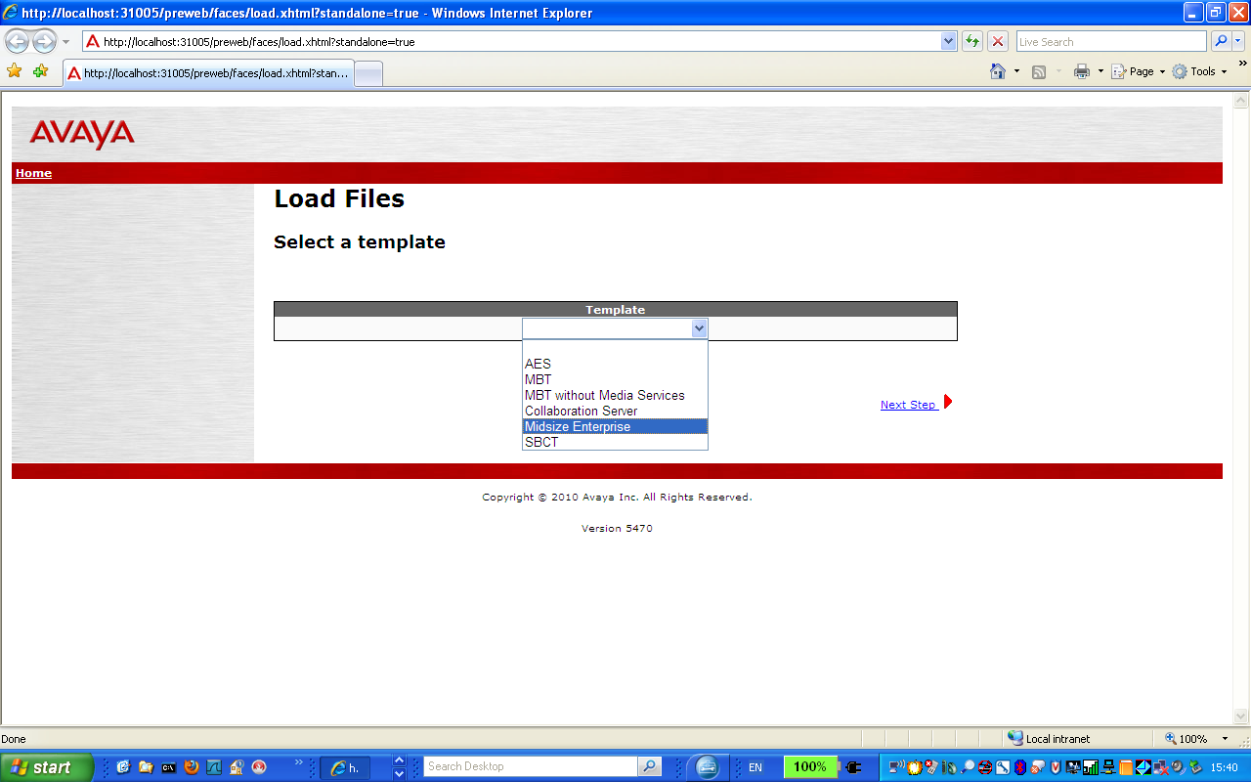
ME Installation Wizard
Notes:
The Installation Wizard supports five (5) products. We want to run it for “ME”, the Midsize Enterprise.

Slide 60
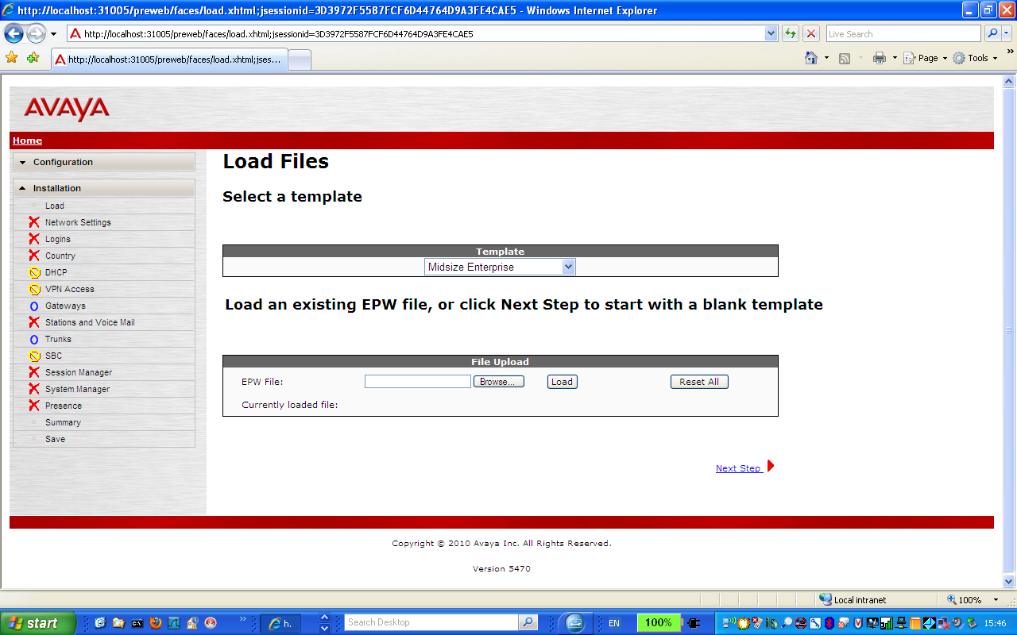
ME Installation Wizard
Notes:
We’ll start with a blank template, i.e., we don’t yet have an EPW file that we could load in order to pre-populate fields on the Wizard’s forms.
The Wizard produces an EPW file as its final output. Once we have that EPW, we can use it during template installation, or reload it into the Standalone Installation Wizard and make any desired changes.

Slide 61
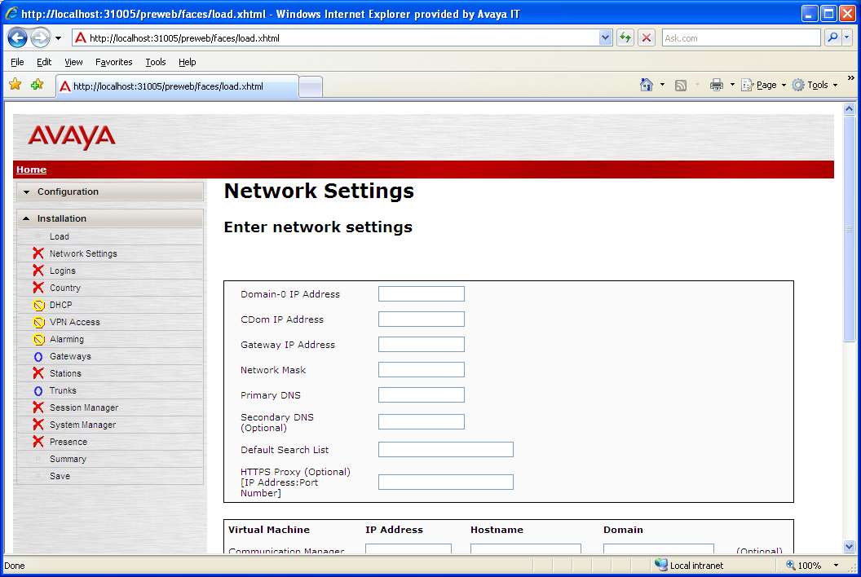
ME Installation Wizard
We don’t yet have an EPW.zip file, so we fill in the blanks using the Intelligent
Workbook. First, we enter the network settings.

Slide 62
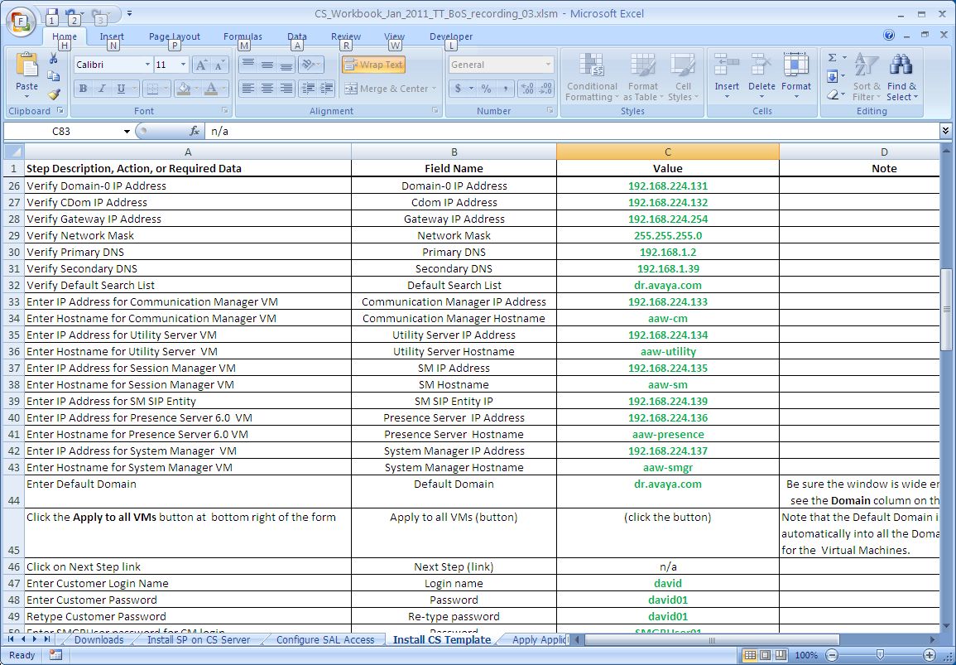
ME Installation Wizard
The Network Settings values come from the “Install ME Template worksheet
in the Intelligent Workbook

Slide 63
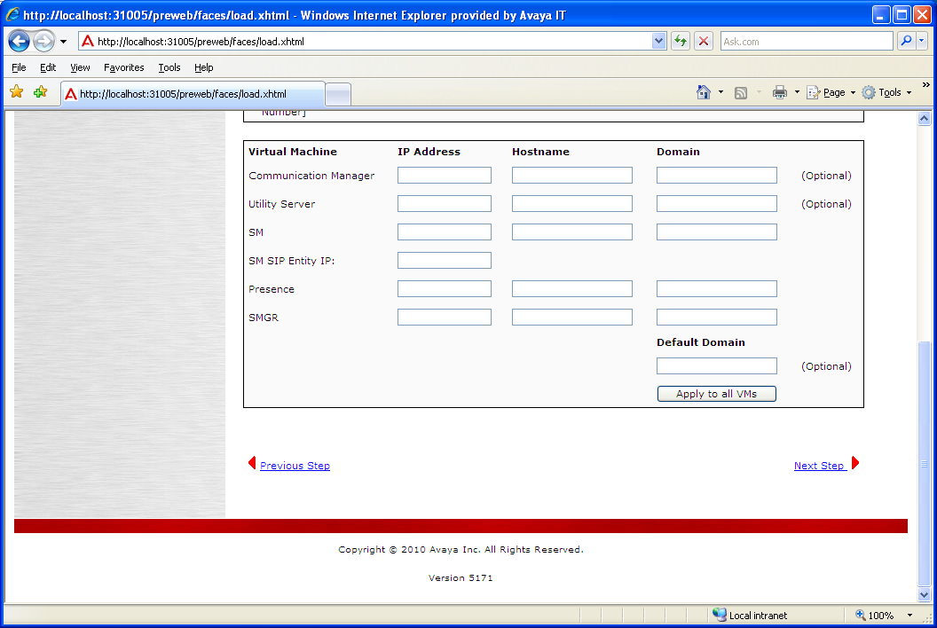
ME Installation Wizard
Next we enter the VM IP Addresses and Hostnames

Slide 64
ME Installation Wizard
The VM values also come from the “Install ME Template worksheet
in the Intelligent Workbook

Slide 65
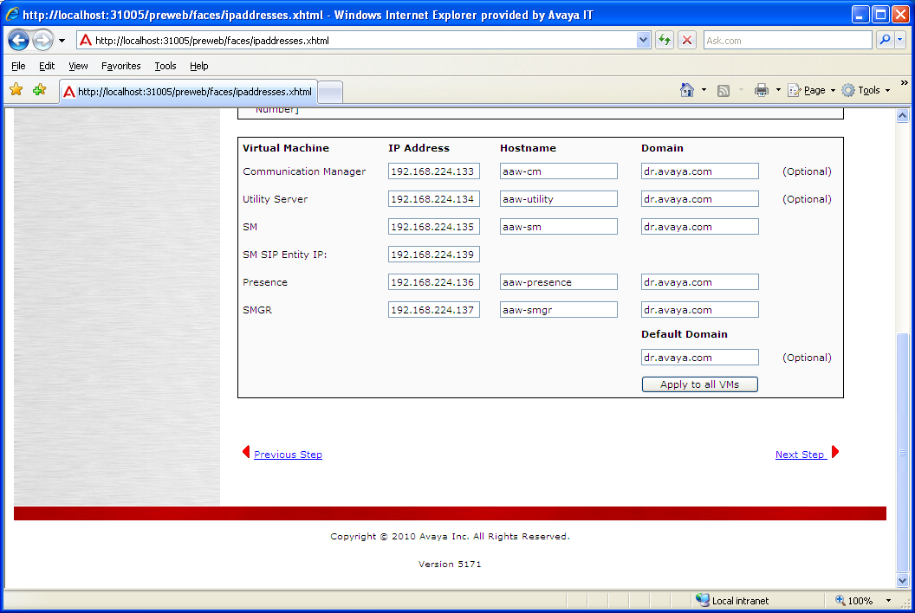
ME Installation Wizard
Once the Default Domain value is entered, clicking the “Apply to all VMs”
button populates the same value into all the Domain entries for the VMs.

Slide 66
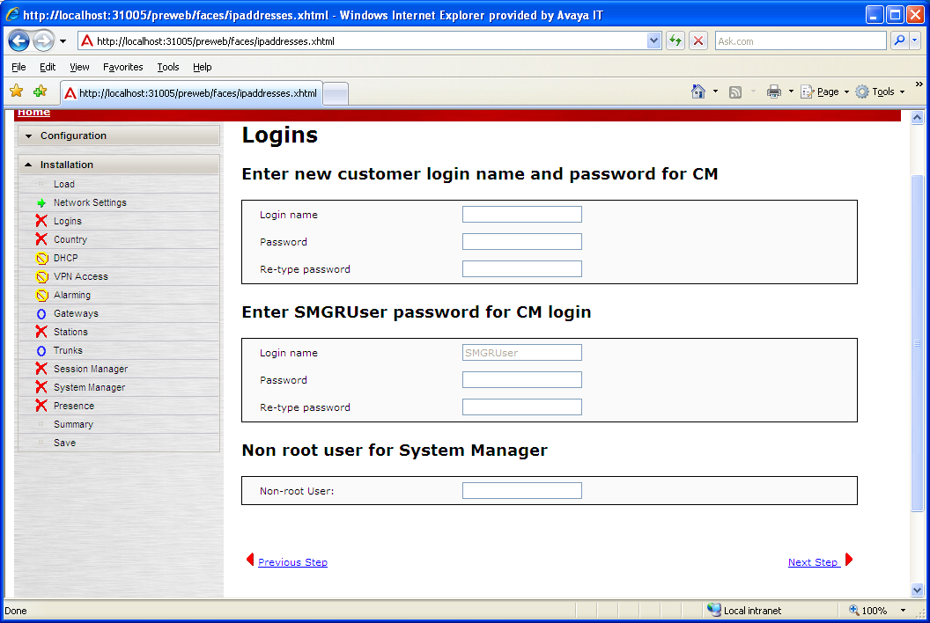
ME Installation Wizard
Next we configure the customer superuser login/password,
SMGRUser password, and SMGR user
Notes:
The superuser login/password is the account we use to access the CM virtual machine for CLI or browser sessions and to run the SAT.
The SMGRUser account is the account that SMGR uses when it logs into CM in order to execute administrative commands like “add station”, “change off-pbx station-mapping”, etc.

Slide 67
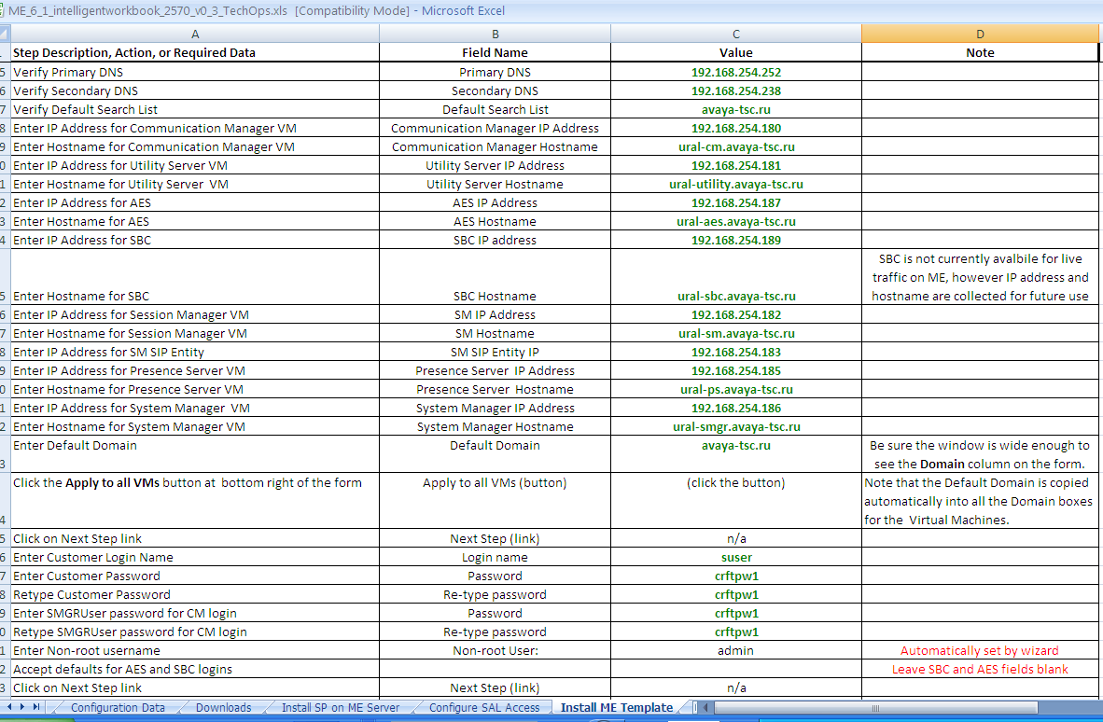
ME Installation Wizard
Intelligent Workbook location of Login/Password values
Note: Non-root username must be admin!
Notes:
The Non-root username MUST be admin!

Slide 68
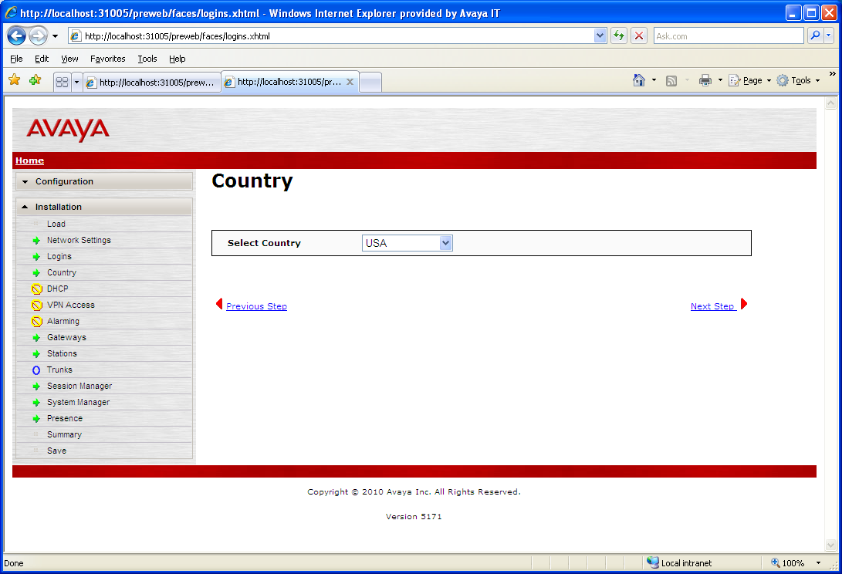
ME Installation Wizard
Select appropriate country from drop-down list

Slide 69
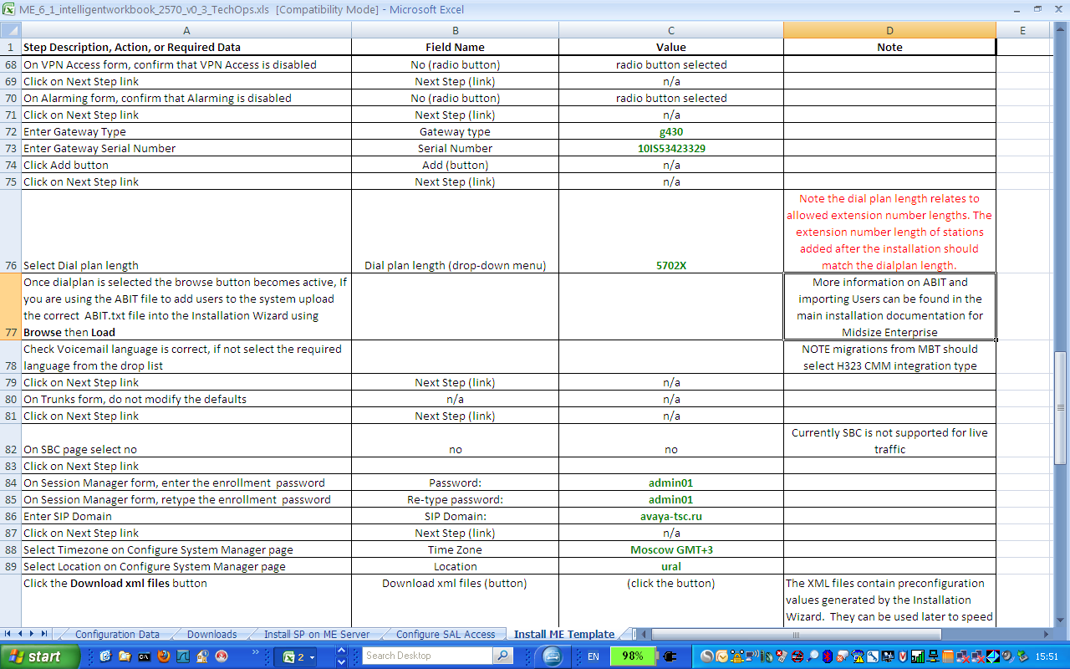
ME Installation Wizard
Intelligent Workbook location of values for media gateway, dial plan, enrollment password, and SIP domain.

Slide 70
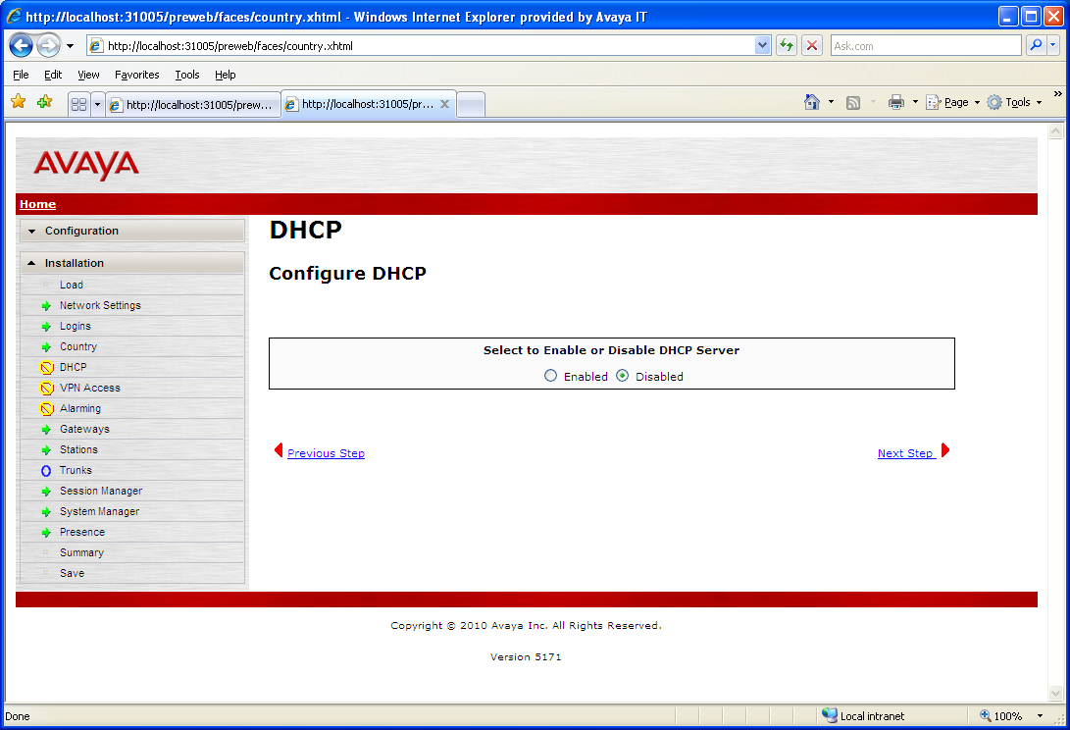
ME Installation Wizard
Configuration of the DHCP server in the Utility Server VM is optional

Slide 71
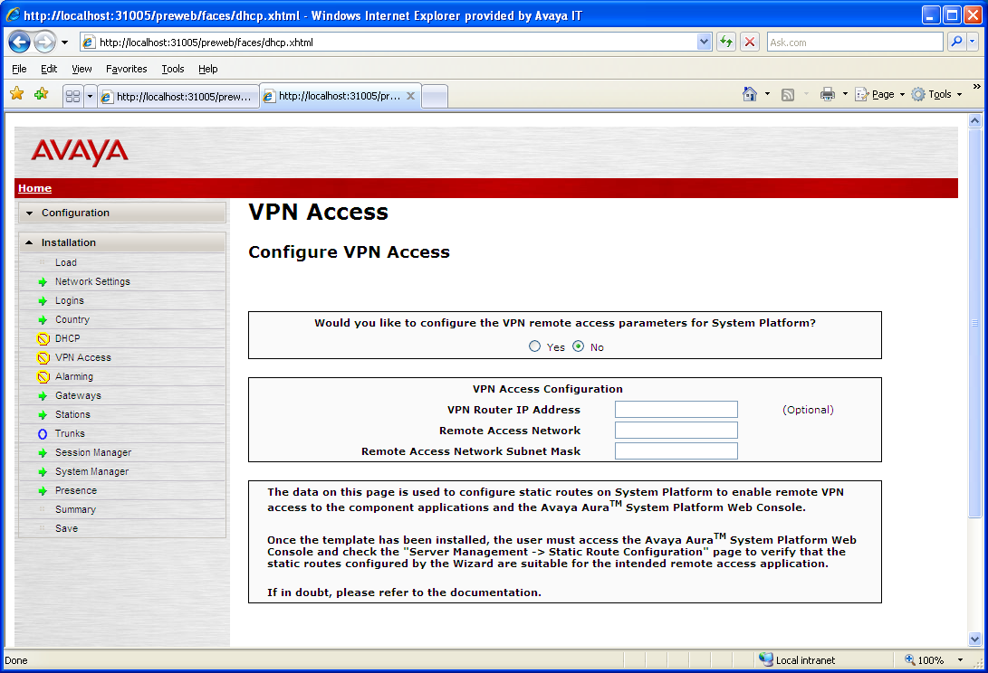
ME Installation Wizard
Skip VPN Access Configuration

Slide 72
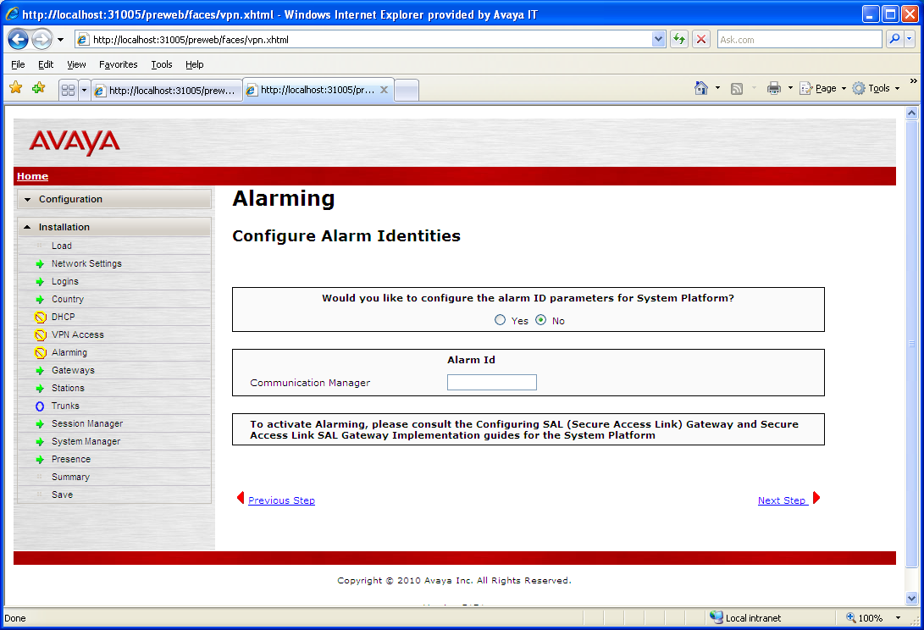
ME Installation Wizard
Skip Alarming Configuration

Slide 73
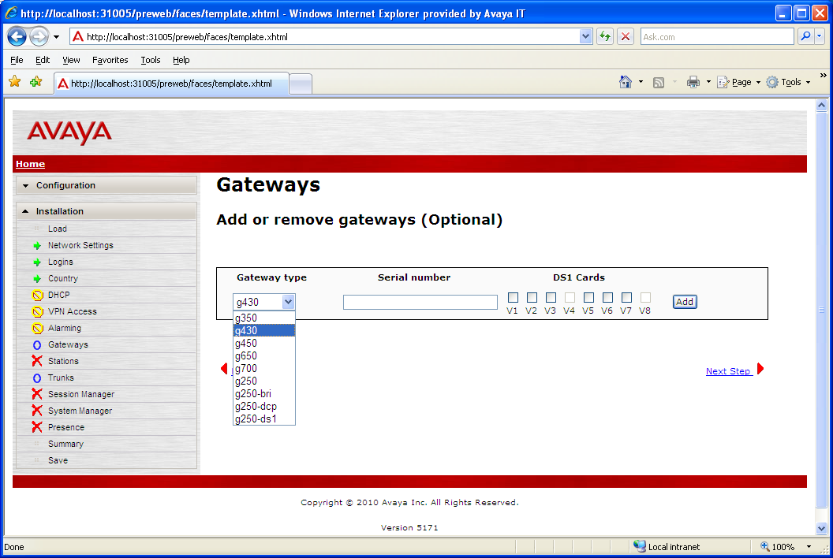
ME Installation Wizard
Select Media Gateway Type from drop-down list,

Slide 74
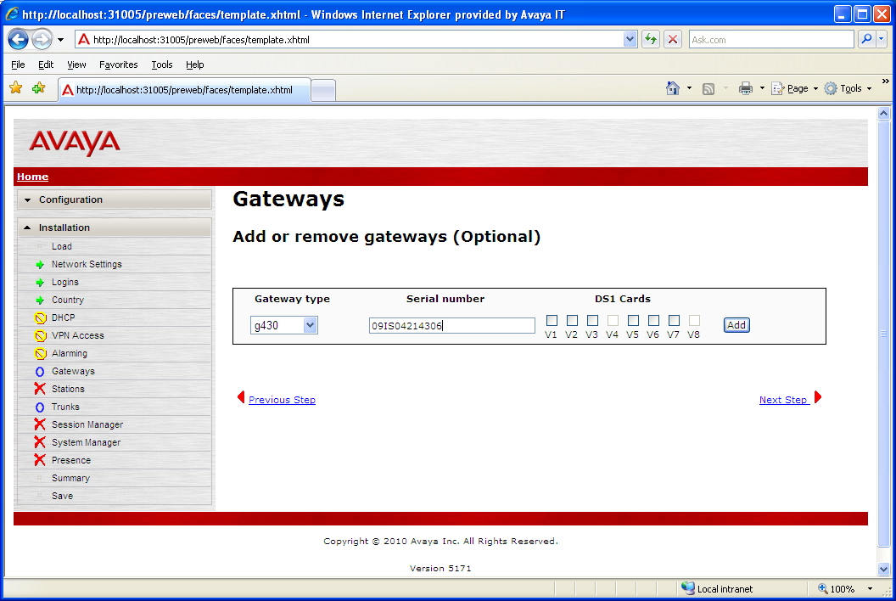
ME Installation Wizard
Enter Media Gateway serial number, click “Add” button

Slide 75
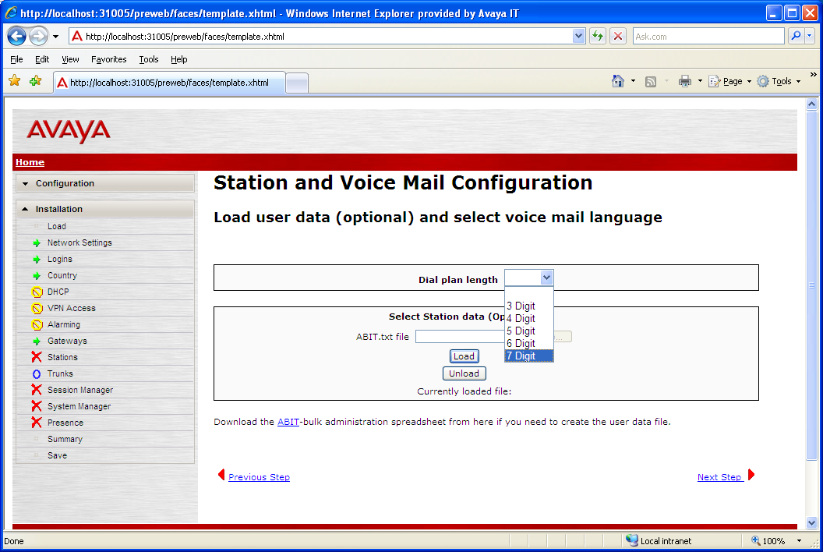
ME Installation Wizard
Select from drop-down list the length of dial plan for CM

Slide 76
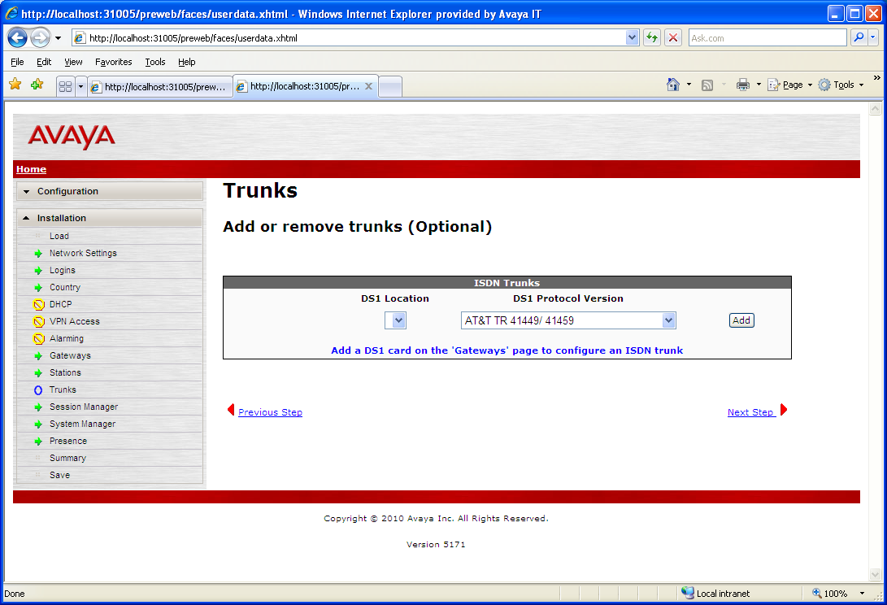
ME Installation Wizard
Skip trunks

Slide 77
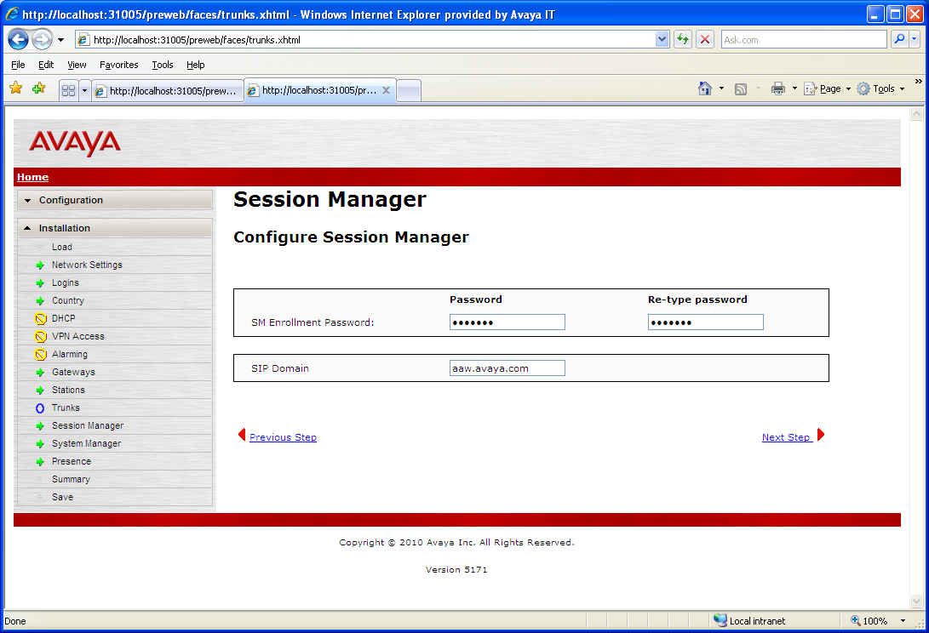
ME Installation Wizard
Enter Enrollment Password and SIP Domain. Note: SIP Domain might be different than the DNS Domain specified during System Platform install
Notes:
The enrollment password gets entered into both Session Manager (SM) and System Manger (SMGR) during the template post-install script execution. Then when SM and SMGR need to exchange certificates in order to set up their secure connection with each other, SMGR can authenticate SM’s connection request by checking that the SM’s presented enrollment password is correct. Then the certificate exchange takes place painlessly (and invisibly) via the Secure Certificate Exchange Protocol, without human intervention.
The enrollment password is normally created along with an expiration timer value from 1 hour to 4 weeks. When that timer expires, the enrollment password becomes invalid, and any subsequent attempts to connect new SMs to the system will fail until a new enrollment password and timer value are administered.
You can create a new enrollment password and timer value in SMGR by navigating to Services -> Security -> Certificates -> Enrollment Password.

Slide 78
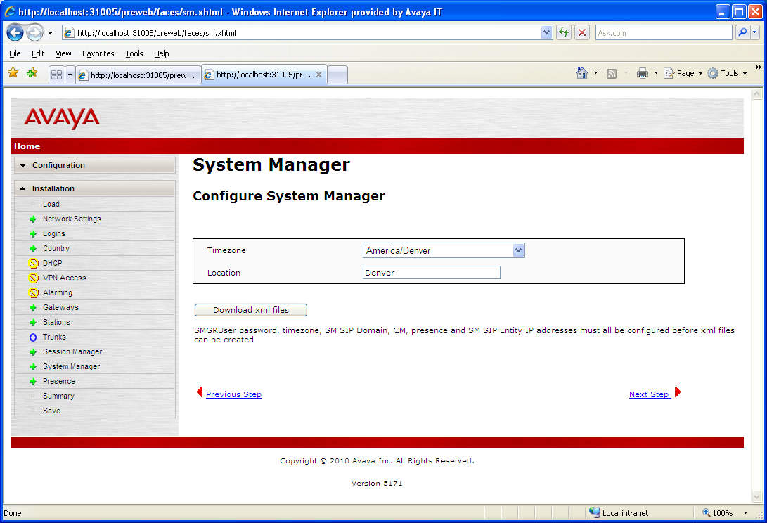
ME Installation Wizard
Download XML
Files
Select Timezone, enter Location, then click the “Download xml files” button

Slide 79
ME Installation Wizard – XML Files Download
What happens when you push the “Download xml files” button?
  The Installation Wizard creates and writes to your filesystem a zipfile, e.g., aaw-smgr_import_files.zip
  The zipfile contains two (or 3 files) files that you later import to configure SMGR:
    NRPImportData.zip (contains four xml files)
    RTSElements.xml
    users.xml
During your configuration of SMGR routing pages, you import NRPImportData.zip to configure Routing values.
During your configuration of SMGR inventory pages, you import RTSElements.xml to configure Inventory values.

Slide 80
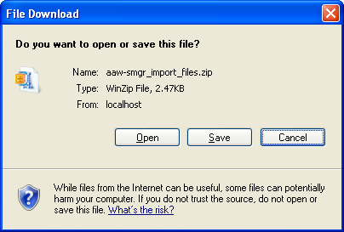
ME Installation Wizard – XML Files Download
File Download Windows dialogue for XML files download

Slide 81
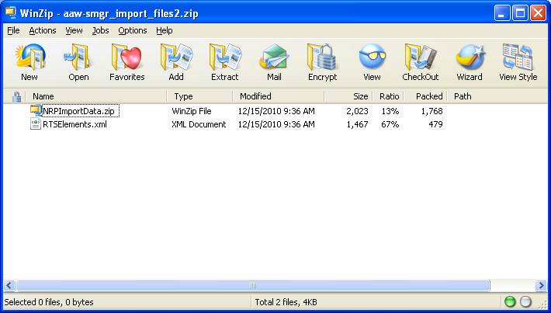
ME Installation Wizard – XML Files Download
Contents of exported XML file zipfile,
smgr_import_files.zip. Note that the parent zipfile
Contains another zipfile, NRPImportData.zip
!!Warning!!
Use only WinZip on these zipfiles: The
default zipfile utility in Windows 7 corrupts
the files during extraction!

Slide 82
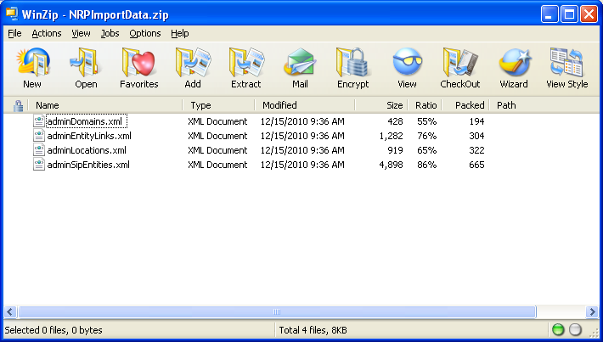
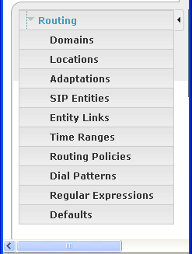
ME Installation Wizard – XML Files Download
Note corresponding entries in
SMGR Routing Configuration
Navigation Pane

Slide 83
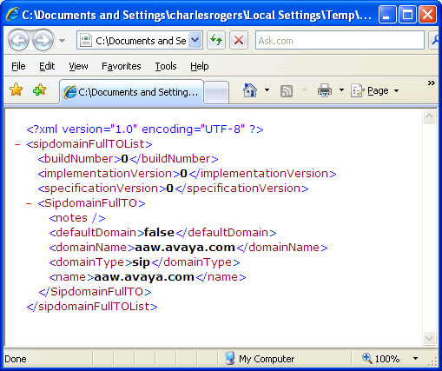
ME Installation Wizard – XML Files Download
adminDomains.xml
----------------------------
SMGR uses these
directives to set its
internal values, in this
case for the
SIP Domain,
aaw.avaya.com

Slide 84
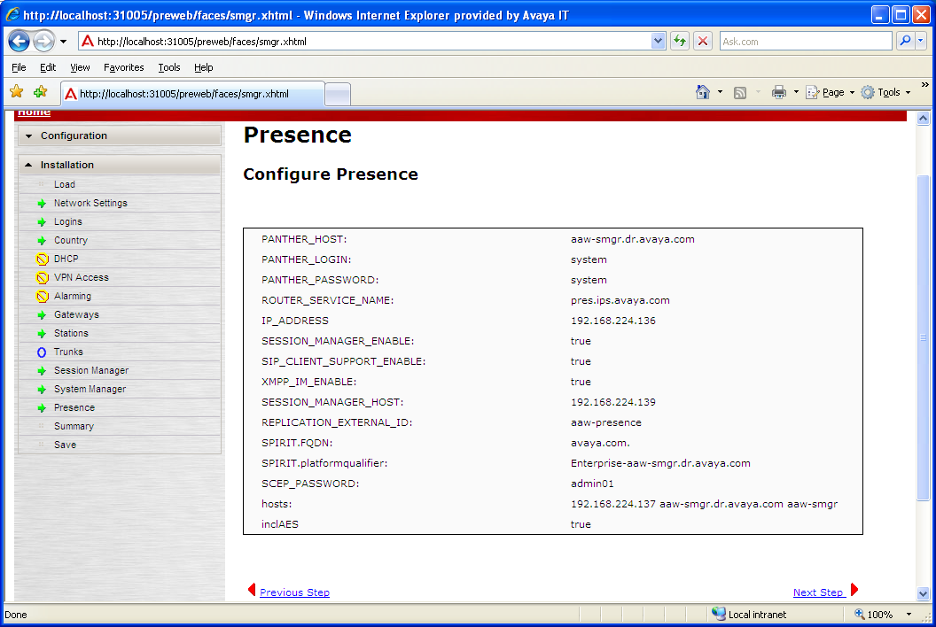
ME Installation Wizard
Confirm presence server settings
Notes:
Note that the Installation Wizard configures all the Presence values based on the data that you’ve already entered. This screen is presented so that you can confirm that the correct values were used.

Slide 85
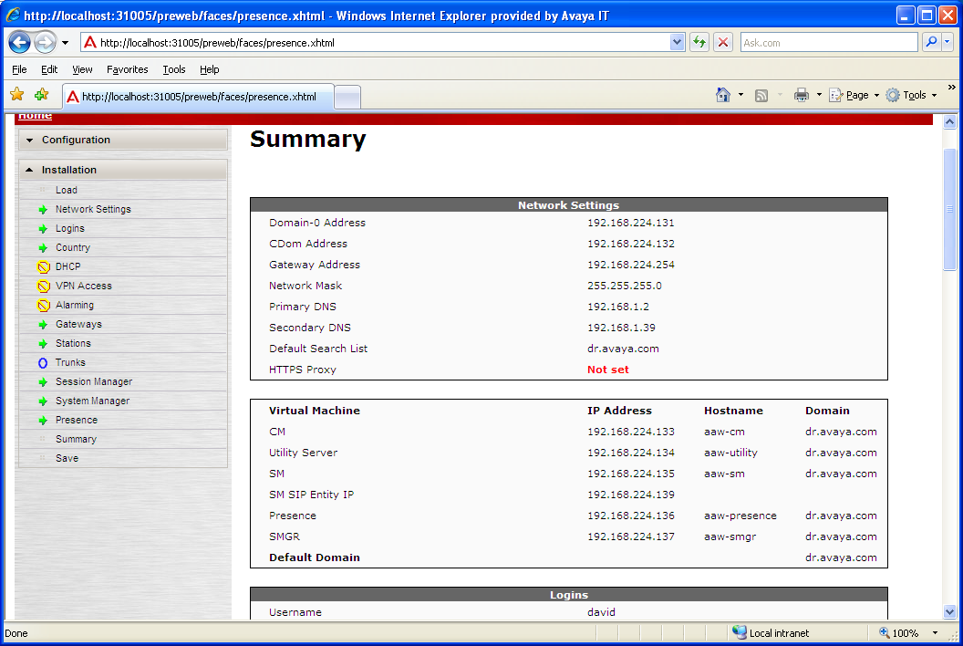
ME Installation Wizard
Check values in the Summary, including Not set values
Notes:
The Not set values correspond to forms that we skipped during our dialogue with the Installation Wizard.
Carefully check each of the Not set values to be sure that you actually intended that value to be Not set.

Slide 86
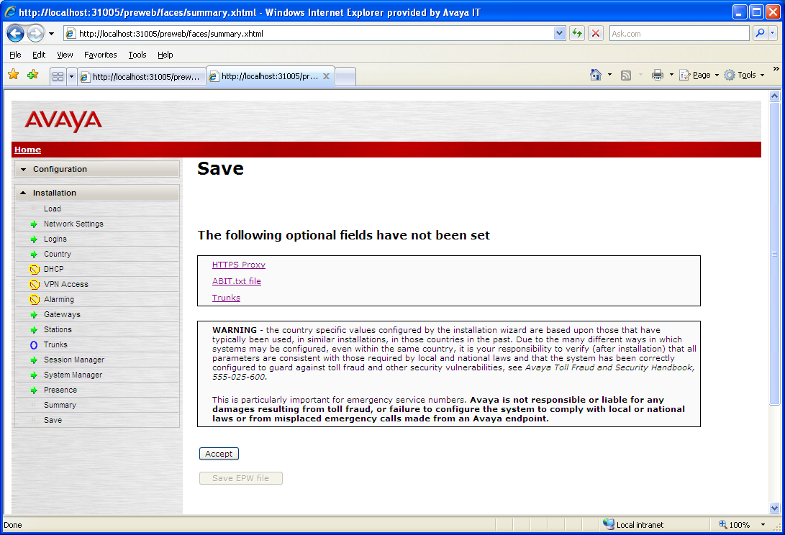
ME Installation Wizard
Click “Accept” button to confirm the Summary values

Slide 87
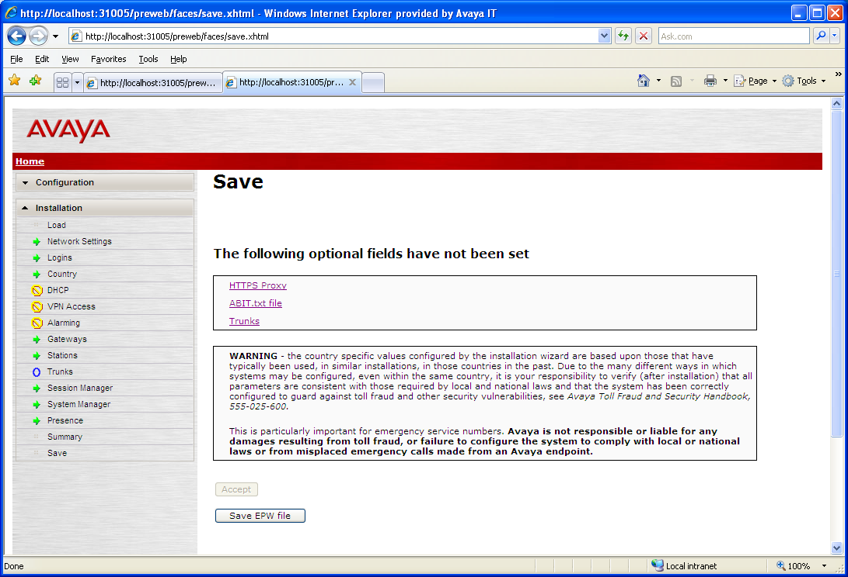
ME Installation Wizard
In the Template-embedded Installation
Wizard, this button is “Install”. In the standalone
Installation Wizard, clicking it causes the file, epw.zip
to be written out to the laptop filesystem

Slide 88
ME Installation Wizard
To exit the Standalone Installation Wizard
just kill the window

Slide 89
ME Installation Wizard
You will also need to kill the command window that
launched the Standalone Installation Wizard window

Slide 90
Installation – Steps 3 and 4
Fill out Configuration Data Worksheet in Intelligent Workbook
Run the standalone Installation Wizard to ME generate the EPW file.
Install ME Server and Media-Gateway in Rack, connect Power, LAN
Configure Media-Gateway
Install System Platform 6.0.3.0.2 software and update (30 minutes)
Configure SAL and register the system
Install ME template (2 - 4 hours)
Apply latest VM updates (CM, SMGR, Presence Server)
Configure SMGR, Presence Server, Endpoints (1 hour)
Install License and Authentication Files (10 minutes)
Connect Endpoints and verify calls

Slide 91
Installation – Install Hardware, Configure MG
Install ME Server and Media-Gateway in Rack, connect Power, LAN
  ME Server requires a 4-post rack
  Connect two (2) AC power cables to the ME Server Power Supplies
  Connect Ethernet cable from ME eth0 to a 100BaseT LAN switch port
  Connect Laptop Ethernet cable to ME eth1 (Services Port)
    Crossover is not required – ME Server NICs are auto-MDIX
    Alternative installation – Connect Keyboard/Mouse/Monitor to ME Server
Configure Media-Gateway
  Install Media-Gateway in Rack, connect AC Power cable
  Connect Ethernet cable from LAN 10/3 jack to 100BaseT LAN switch port
  Configure Media-Gateway networking using standard procedures
    New MG: Use configuration script that runs on first boot
    Re-used MG: Execute nvram init, then use configuration script after reboot

Slide 92
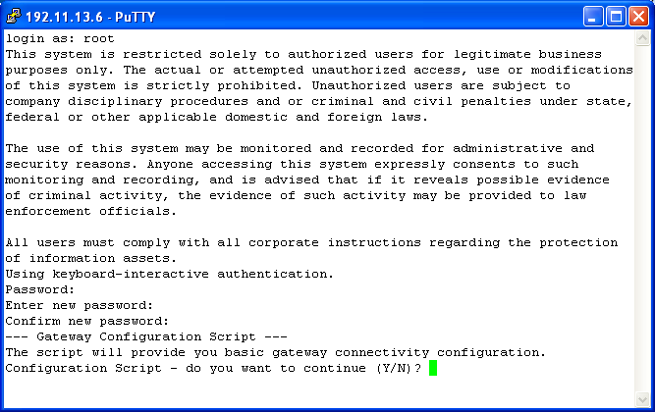
Installation – Configure Media Gateway
New G430 Media Gateway: initial SSH Services Port login as root (password root, rootroot, or rootroot0). Enter “Y” to run the Configuration Script.

Slide 93
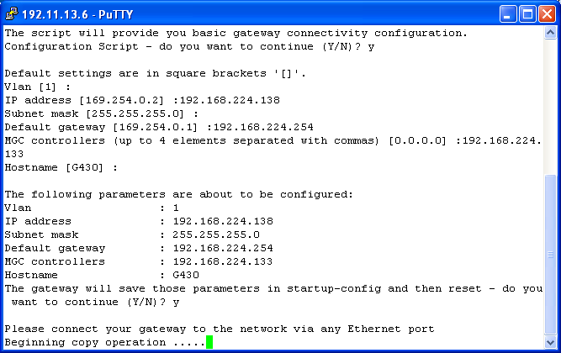
Installation – Configure MG
Enter desired values for IP Address, etc., or press Enter to accept each default value. The Media Gateway self-reboots using the new values when the copy operation is complete.

Slide 94
Installation – Step 5
Fill out Configuration Data Worksheet in ME Intelligent Workbook
Run the standalone Installation Wizard to generate the EPW file.
Install ME Server and Media-Gateway in Rack, connect Power, LAN
Configure Media-Gateway
Install System Platform 6.0.3.0.2 software and update (30 minutes)
Configure SAL and register the system
Install ME template (2 - 4 hours)
Apply latest VM updates (CM, SMGR, Presence Server)
Configure SMGR, Presence Server, Endpoints (1 hour)
Install License and Authentication Files (10 minutes)
Connect Endpoints and verify calls

Slide 95
Topology View – System Platform Installation
DOM-0 (Xen Hypervisor)
Console
Domain
LAN
Install System Platform on ME Server, configure networking:
DOM-0 IP Address and FQDN (not just hostname!)
CDOM IP Address and FQDN (not just hostname!)
Subnet Mask
Primary and Secondary DNS Server IP Addresses
Default Gateway (router)
IPV4 Forwarding Enabled
Time Zone, Date/Time, NTP Server IP Address
Default Login Passwords (root, admin, cust, LDAP)
95
Notes:
95

Slide 96
Installation – Install System Platform 6.0.3.0.2
Choose ME Server access method for the install:
  Connect Laptop Ethernet to Server’s eth1, or
  Attach Keyboard/Monitor to Server USB and SVGA jacks
Power-on ME Server
Insert System Platform 6.0.3.0.2 CD in CD/DVD Drive
If using Keyboard/Monitor:
  Press any key when Avaya Aura® splash screen appears
  After 30 seconds, installer ignores further keyboard input
If using laptop:
  Ping 192.11.13.6 until Server responds

Slide 97
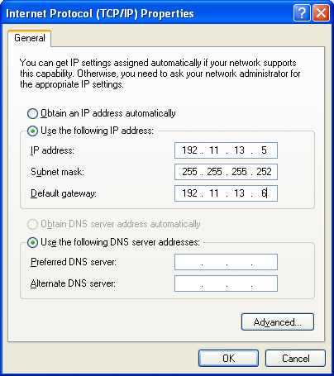
Installation – Install System Platform 6.0.3.0.2
Reconfigure your laptop Ethernet for Avaya Services Port access as shown
Confirm that your laptop’s default gateway is set to 192.11.13.6 so that you can access all VMs via the Services Port
Notes:
Note: the default passwords are created by appending “01” to the account name, e.g., root/root01. For well-protected lab systems or training sessions, the default passwords are adequate. Customers typically want more secure passwords. The ME Intelligent Workbook’s Configuration Data worksheet provides entries for these password values, and you must populate them as part of your pre-installation preparation.

Slide 98
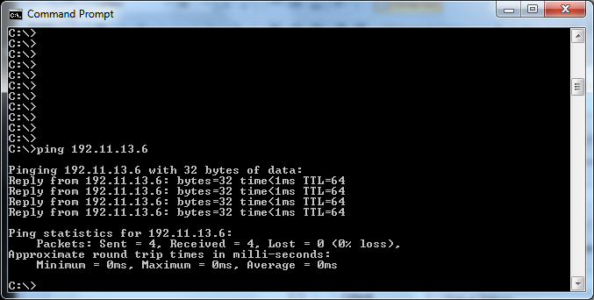
Install SP-6.0.3.0.2
Ping the services port IP address until Server responds

Slide 99
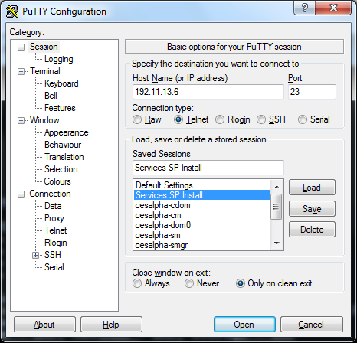
Install SP-6.0.3.0.2
Configure Putty Telnet Session for the ME Services Port

Slide 100
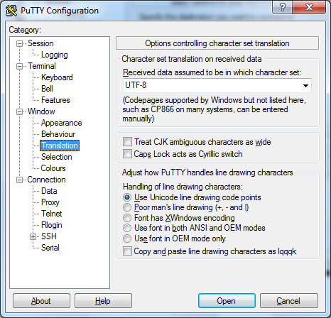
Install SP-6.0.3.0.2
Select UTF-8
Translation, then
click “Open” to
launch session
Select Specific Character Set Translation – UTF-8

Slide 101

Install SP-6.0.3.0.2
Select Keyboard Type

Slide 102

Install SP-6.0.3.0.2
Tab to OK, Press Enter to submit the form

Slide 103

Install SP-6.0.3.0.2
Media Test is time-consuming, skip if you trust the CD

Slide 104

Install SP-6.0.3.0.2
System Platform Installer requires ~30 seconds to load

Slide 105

Install SP-6.0.3.0.2
Enter values from the ME6.1 Intelligent Workbook
Notes:
Hostname = FQDN

Slide 106

Install SP-6.0.3.0.2
Note: The form asks
for “Hostname:”, but
you must enter an FQDN
This is the only way to
specify the DNS domain
of the ME Server to
System Platform
When entry is complete, tab to OK and press Enter

Slide 107

Install SP-6.0.3.0.2
Acknowledge the warning, select OK and press Enter

Slide 108

Install SP-6.0.3.0.2
Continue data entry for the Console Domain
Notes:
Hostname = FQDN

Slide 109

Install SP-6.0.3.0.2
Note: The form asks
for “Hostname:” for
the Console Domain as
well, but you must enter
an FQDN here too.
When entry is complete, tab to OK and press Enter

Slide 110

Install SP-6.0.3.0.2
Scroll to correct Time Zone, tab to OK and press Enter

Slide 111

Install SP-6.0.3.0.2
Correct the Date/Time, enter NTP Server address/FQDN, tab to OK and press Enter (see note off-slide below)
Notes:
Note: We recommend that you use NTP and specify an NTP server here. Correct real-time timestamps in the logs make log analysis much easier. Also, if you are debugging multiple systems at a customer site, it is much easier to correlate log events if their timestamps are all based on a common time reference.

Slide 112

Install SP-6.0.3.0.2
Accept default passwords or modify them, tab to OK and press Enter (see note off-slide below)
Notes:
Note: the default passwords are created by appending “01” to the account name, e.g., root/root01. For well-protected lab systems or training sessions, the default passwords are adequate. Customers typically want more secure passwords. The ME Intelligent Workbook’s Configuration Data worksheet provides entries for these password values, and you must populate them as part of your pre-installation preparation.

Slide 113

Install SP-6.0.3.0.2
SP Installer formats the filesystem
Notes:
Note: the default passwords are created by appending “01” to the account name, e.g., root/root01. For well-protected lab systems or training sessions, the default passwords are adequate. Customers typically want more secure passwords. The ME Intelligent Workbook’s Configuration Data worksheet provides entries for these password values, and you must populate them as part of your pre-installation preparation.

Slide 114

Install SP-6.0.3.0.2
SP Installer transfers install image to hard drive
Notes:
Note: the default passwords are created by appending “01” to the account name, e.g., root/root01. For well-protected lab systems or training sessions, the default passwords are adequate. Customers typically want more secure passwords. The ME Intelligent Workbook’s Configuration Data worksheet provides entries for these password values, and you must populate them as part of your pre-installation preparation.

Slide 115

Install SP-6.0.3.0.2
SP Installer installs software images. When this step is complete, the ME server ejects the SP CD and reboots.
Notes:
Note: the default passwords are created by appending “01” to the account name, e.g., root/root01. For well-protected lab systems or training sessions, the default passwords are adequate. Customers typically want more secure passwords. The ME Intelligent Workbook’s Configuration Data worksheet provides entries for these password values, and you must populate them as part of your pre-installation preparation.

Slide 116

Accessing SP-6.0.3.0.2
Ping the Services Port address to determine when reboot has completed. When ME Server responds, proceed.
Notes:
Note: the default passwords are created by appending “01” to the account name, e.g., root/root01. For well-protected lab systems or training sessions, the default passwords are adequate. Customers typically want more secure passwords. The ME Intelligent Workbook’s Configuration Data worksheet provides entries for these password values, and you must populate them as part of your pre-installation preparation.

Slide 117

Accessing SP-6.0.3.0.2
Launch Putty SSH Session to ME Services Port, specifying SSH protocol with port 22
Notes:
Note: the default passwords are created by appending “01” to the account name, e.g., root/root01. For well-protected lab systems or training sessions, the default passwords are adequate. Customers typically want more secure passwords. The ME Intelligent Workbook’s Configuration Data worksheet provides entries for these password values, and you must populate them as part of your pre-installation preparation.

Slide 118

Accessing SP-6.0.3.0.2
Select Latin-1
Translation, then
click “Open” to
launch session
Set Character Set Translation – Latin-1 West Europe

Slide 119

Accessing SP-6.0.3.0.2
Click “Yes” to trust the ME Server and proceed

Slide 120

Accessing SP-6.0.3.0.2
Login with admin/admin01
Change user to root/root01
First DOM0 SSL CLI Access.
Note Instructions for xm list
and xm console commands
Attempt Console CDOM Session

Slide 121

Accessing SP-6.0.3.0.2
Note: At this point, you cannot open a browser session to CDOM, nor can you login as console here. CDOM appears to be stuck at “Starting vsp_firstboot”, but the first CDOM restart after a System Platform install requires ~15 Minutes to complete. Be Patient.
Notes:
I’m having you attempt this access so you’ll understand why you can’t talk to the CDOM with a CLI session or browser until ~15 minutes after the first boot following System Platform installation. It’s easy to conclude that System Platform is broken when your browser and CLI sessions won’t connect during this time, but it’s not broken, it’s just initializing itself. Be patient.

Slide 122

Accessing SP-6.0.3.0.2
After ~15 minutes, CDOM
finally breaks loose, finishes
first restart initialization tasks,
then offers login prompt

Slide 123

Installation – Install System Platform 6.0.3.0.2
Begin CDOM login
Success! Browser login
to CDOM is now also possible.
Note: to exit console session and
return to dom0 CLI prompt,
enter ctrl-]
Notes:
When you’re done in CDOM and want to fall back to your dom0 session, you can’t exit the “xm console udom” session by entering “exit”. That will just get you another CDOM login: prompt.
To exit the “xm console udom” session, you hit the cntrl-] character pair. (This same pair has been used historically to exit telnet sessions as well.)

Slide 124
Installation – Step 6
Fill out Configuration Data Worksheet in ME Intelligent Workbook
Run the standalone Installation Wizard to generate the EPW file.
Install ME Server and Media-Gateway in Rack, connect Power, LAN
Configure Media-Gateway
Install System Platform 6.0.3.0.2 software and update (30 minutes)
Configure SAL and register the system
Install ME template (2 - 4 hours)
Apply latest VM updates (CM, SMGR, Presence Server)
Configure SMGR, Presence Server, Endpoints (1 hour)
Install License and Authentication Files (10 minutes)
Connect Endpoints and verify calls

Slide 125
ME Topology View – SAL Configuration
DOM-0 (Xen Hypervisor)
Console
Domain
SAL
LAN
Configure Secure Access Link for Remote Access and Alarming:
Login on CDOM via browser session
Configure and test remote access to the ME server
See the following document for instructions:
  “Job Aid: Administering Remote Access and Alarming for Avaya Aura® Collaboration Server (CS) 6.1 Using Secure Access Link (SAL)”
    https://support.avaya.com/css/P8/documents/100124786
125
Notes:
125

Slide 126
Installation – Step 7
Fill out Configuration Data Worksheet in ME Intelligent Workbook
Run the standalone Installation Wizard to generate the EPW file.
Install ME Server and Media-Gateway in Rack, connect Power, LAN
Configure Media-Gateway
Install System Platform. 6.0.3.0.2 software and update (30 minutes)
Configure SAL and register the system
Install ME template (2 - 4 hours)
Apply latest VM updates (CM, SMGR, Presence Server)
Configure SMGR, Presence Server, Endpoints (1 hour)
Install License and Authentication Files (10 minutes)
Connect Endpoints and verify calls

Slide 127
Topology View – Template Installation
DOM-0 (Xen Hypervisor)
Console
Domain
CM
SM
System
Manager
Presence
Server
Utility
Server
AE
Server
SBC
LAN
Admin Installs ME Template from CDOM Browser Session:
Admin selects the ME Template to install, specifying USB, DVD or PLDS
Template Installer copies VM images onto hard drive from USB, DVD or PLDS
Template Installer creates web application, launches ME Installation Wizard
ME Installation Wizard loads EPW or collects configuration data from user
ME Installation Wizard generates XML files for later use in SMGR configuration
Template Installer assigns resources, sets up networking for VMs
Template Installer installs the individual VMs, restarts VMs and networking
Template Installer launches the Post-Install Plug-in
127
Notes:
127

Slide 128
ME Installation media
Copy ME template ISO images:
  Midsize_Ent-6.1.0.0.2570-1.iso
  Midsize_Ent-6.1.0.0.2570-2.iso
  Midsize_Ent-6.1.0.0.2570-3.iso
Verify checksum with md5sum:
e7915df1de3dbf4d6ae218754fe50dc1 Midsize_Ent-6.1.0.0.2570-1.iso
f0c79705a8d887de462030e64441f63f Zidsize_Ent-6.1.0.0.2570-2.iso
65892e8e7703368aa520c077ab51b992 Midsize_Ent-6.1.0.0.2570-3.iso
Insert 16G+ FAT32 USB drive into your Windows PC let the PC find and configure it with a drive letter ;
Mount ME ISO images and copy content onto USB drive;
Using WinZip v12.1 or later open each ISO 2570 image and unpack them directly to the USB stick (20~25 mins/ISO).-
* Note: when extracting make sure to check "overwrite existing files“ since the TRANS.TBL file is duplicated on each ISO image.

Slide 129

Installation – Install Template
Login to CDOM as admin

Slide 130

Installation – Install Template
Click “I Accept” button

Slide 131

Installation – Install Template
Note that we have two VMs: dom0 and cdom

Slide 132

Installation – Install ME template
Select SP Server
Navigate to Virtual Machine Management -> Solution Template
Select Template Installation Media, Click “Search” button

Slide 133

ME Template DVD installation – File Manager
Push “View DVD/CD” button
Select “File Manager” tab

Slide 134

ME Template DVD installation – File Copy
Select Files
Start Copy

Slide 135

ME Template DVD installation – Disk Eject
Eject 1st Disk and install next

Slide 136

ME Template DVD installation – Capacity Control
“Finalize Copy” to finish ME template transfer process

Slide 137

Installation – Install ME template
Select USB as installation source

Slide 138

Installation – Install ME template
Highlight Template to Install
Click “Select” button

Slide 139

Installation – Install ME template
Browse, Select and Load EPW File Generated by ME Installation Wizard, or
Click “Continue without EPW file” button and enter Wizard values manually

Slide 140

Installation – Install ME template
Locate EPW file in Windows filesystem

Slide 141

Installation – Install ME template
Click “Upload EPW file” button

Slide 142

Installation – Install ME template
Confirm VM Versions and Launch Template Install

Slide 143

Installation – Template Files copied into CDOM
Note Directory where
Template Files are copied
Template
Manifest File
Notes:
The template installer downloads the template configuration and image files into /vsp-template/Midsize_Ent in CDOM hard disk space.
The downloaded files include:
The .ovf (Open Virtualization Format) file that defines the template.
The .mf (Manifest File) file that contains SHA1 checksum values for all the template files.
The .gz and .bz2 image files for the virtual machines
The .sh plug-in shell scripts.
The .war and .tar pre- and post- install scripts.
The downloaded files remain here after the template installation is complete. If you delete the template and re-install, the re-install takes less time because the files are still there, and do not have to be re-loaded onto the hard drive.

Slide 144


Installation – Template Manifest File
Expected
Checksum
Actual Checksum
Matches Manifest
File Checksum
Notes:
The template installer confirms the SHA1 checksum on each file listed in the manifest file, and if a calculated checksum does not match the manifest file checksum, template installation halts with a checksum error.
You can manually confirm file checksums by running the sha1sum command on the file of interest, as shown in the lower part of the slide.

Slide 145

Installation – Install ME template
Wizard
Launches
Here
Notes:
Some of these actions take place in parallel, and others wait for earlier actions to complete because of dependencies.
The Installation Wizard (embedded in the template installer) launches at the line, “Wait for User to Complete Data Entry”.

Slide 146

Installation – Install ME template
Without EPW, Wizard
Collects data
With EPW, Wizard
Displays data
Installation Wizard displays the same pages, collecting values or displaying values already provided in the EPW file for confirmation
Notes:
If you didn’t specify an EPW file, then when the Installation Wizard runs, you must fill in all the blanks.
If you did provide an EPW file, then you just confirm that the pre-populated values are correct.

Slide 147

Installation – Install ME template
Data collection/confirmation complete – Click “Accept” and then “Install”

Slide 148

Installation – Install ME template
SMGR Patch Applied here
CM Configuration begins here

Slide 149

Installation – Install ME template
Configure G430 in CM

Slide 150


Installation – Install ME template
Notes:
The template installation continues in the background if you log off, or if your session is timed out by idle-session timers. If you log back in before template installation is complete, you are taken back to this page.
The template installation log is always available once the initial installation is complete. You can review it by browsing to CDOM, navigating to Virtual Machine Management -> View Install/Upgrade Log. It looks exactly like the template installer output that you see, if you monitor the template installation in real time.

Slide 151
Topology View – Post-Install Plug-in Execution
DOM-0 (Xen Hypervisor)
Console
Domain
CM-ES
SM
System
Manager
Presence
Server
Utility
Server
MG
Registers
Certificate
Exchange
LAN
Template Installer executes Post Install Plug-in:
Automatically applies VM Patches (SMGR, Presence)
Sets Enrollment Password in SM & SMGR (Certificate Exchange)
Configures non-root user in SMGR (used for CLI login)
Modifies VM hosts and DNS configuration files as necessary
Configures Presence Server, Utility Server
Configures CM as CM-ES and administers all CM features
G430 Media Gateway registers with CM-ES
Template Installation completes
G430
MG
151
Notes:
151

Slide 152
Installation – Step 8
Fill out Configuration Data Worksheet in ME Intelligent Workbook
Run the standalone Installation Wizard to generate the EPW file.
Install ME Server and Media-Gateway in Rack, connect Power, LAN
Configure Media-Gateway
Install System Platform 6.0.3.0.2 software and update (30 minutes)
Configure SAL and register the system
Install ME template (2 - 4 hours)
Apply latest VM updates (CM, SMGR, Presence Server)
Configure SMGR, Presence Server, Endpoints (1 hour)
Install License and Authentication Files (10 minutes)
Connect Endpoints and verify calls
Notes:
The Intelligent Workbook specifies patches and service packs that are the latest available at the time of installation.
If newer patches or service packs for System Platform, CM, SMGR, or Presence Server subsequently become GA, you can install those newer patches or service packs.

Slide 153
Topology View – Apply Recent Software Updates
DOM-0 (Xen Hypervisor)
Console
Domain
CM-ES
SM
System
Manager
Presence
Server
Utility
Server
LAN
Apply Patches to VMs and Update G430 Software:
Download latest GA patches for CM, SMGR, and Presence Server
Apply CM patch using CDOM Patch Management feature
Apply SMGR patch (.bin file) using Release Notes instructions
Apply Presence server patch using Release Notes instructions
Download latest G430 Software Update
Update G430 Software
G430
MG
153
Notes:
153

Slide 154

Installation – System Platform Upgrade
Navigate to Server Management -> Patch Management ->
Download/Upload, click “Add” button

Slide 155

Installation – System Platform Upgrade
Navigate to Server Management -> Patch Management ->
Download/Upload, click “Add”, browse for update file, click “Upload”

Slide 156

Installation – System Platform Upgrade
Click “Install”, wait for upgrade installation to complete

Slide 157

Installation – System Platform Upgrade
Wait for Web Console to restart

Slide 158

Installation – CM Patching
Repeat Patching procedure for CM

Slide 159

Installation – SMGR Patch
Launch WinSCP to transfer SMGR patch file to SMGR VM
Use admin/admin login/password
Notes:
SMGR patches are typically .bin files that must be transferred onto the SMGR virtual machine. You will then execute the patch file using a CLI session on SMGR.

Slide 160

Installation – SMGR Patch
Drag SMGR patch file into /tmp in the SMGR VM

Slide 161

Installation – SMGR Patch
Click “Copy” to transfer SMGR patch file

Slide 162

Installation – SMGR Patch
Wait for file copy to complete, then close WinSCP

Slide 163

Installation – SMGR Patch
Open a Putty SSH session to SMGR

Slide 164

Installation – SMGR Patch
Login to SMGR (admin/admin), su – (root01), cd to /tmp

Slide 165

Installation – SMGR Patch
Make the patch executable with chmod. Execute the patch with sh.

Slide 166

Installation – SMGR Patch
Wait for patch file execution to complete, then log off

Slide 167
Installation – Step 9
Fill out Configuration Data Worksheet in ME Intelligent Workbook
Run the standalone Installation Wizard to generate the EPW file.
Install ME Server and Media-Gateway in Rack, connect Power, LAN
Configure Media-Gateway
Install System Platform 6.0.3.0.2 software and update (30 minutes)
Configure SAL and register the system
Install ME template (2 - 4 hours)
Apply latest VM updates (CM, SMGR, Presence Server)
Configure SMGR, Presence Server, Endpoints (1 hour)
Install License and Authentication Files (10 minutes)
Connect Endpoints and verify calls

Slide 168
Topology View – SMGR Manual Configuration
DOM-0 (Xen Hypervisor)
DRS
Console
Domain
CM-ES
SM
System
Manager
Presence
Server
Utility
Server
SIP Trunk
SIP Entity
Link
SIP Entity
Link
LAN
Admin Completes Manual Configuration in SMGR:
Admin imports XML files generated by ME Installation Wizard
Admin adds SM as a Managed Element in SMGR
SMGR replicates data to SM via Data Replication Service (DRS)
SM brings up Asset (aka Security Module, SM100) SIP interface
Admin confirms that SM SIP Entity links to CM-ES, Presence are up
Admin changes SM Service State to Accepting New SIP Requests
SM-to-CM-ES SIP Trunk (Trunk Group 3) comes into service
Admin makes CM-ES the Sequenced Application for SM
G430
MG
168
Notes:
168

Slide 169

Installation – Configure SMGR
Read the Note!
Browse to <SMGR IP Address>/SMGR, Read the Note!
Notes:
First-time browser login to SMGR is not what you probably expect. Read the Note on the login page, and avoid a LOT of frustration.

Slide 170
Installation – Configure SMGR
Click the Link
Click the “Change Password” link

Slide 171

Installation – Configure SMGR
Click this Link to return
to login page
Current admin password is admin123 – New password must meet
the strength requirement described in the note

Slide 172

Installation – Configure SMGR
Login as admin using your newly-created admin password

Slide 173
ME Installation Wizard – XML Files Download
Before importing XML files into SMGR:
  Locate the zipfile that the Installation Wizard downloaded
  Extract the two files shown from the zipfile:
    NRPImportData.zip
    RTSElements.xml
  Note the files’ location in your laptop filesystem
  Warning – Use WinZIP! Do not use the embedded unzip utility that comes with Windows Vista and Windows 7!

Slide 174

Installation – Import SMGR xml files
Navigate to Elements -> Routing

Slide 175

Installation – Import SMGR xml files
Navigate to Domains

Slide 176

Installation – Import SMGR xml files
Select “Import” from the “More Actions” drop-down menu

Slide 177

Installation – Import SMGR xml files
Browse files on your PC
Click the “Browse” button, locate NRPImportData.zip in Windows filesystem (Note: you must have previously unzipped the xml zipfile into the two files, NRPImportData.zip and RTSElements.xml)
Notes:
Import with Firefox might fail. Use IE7.

Slide 178

Installation – Import SMGR xml files
Click the “Import” button,

Slide 179

Installation – Import SMGR xml files
Confirm successful import, then click the “Home” tab

Slide 180
Installation – Import SMGR xml files
Navigate to Elements -> Inventory

Slide 181

Installation – Import SMGR xml files
Navigate to Manage Elements

Slide 182

Installation – Import SMGR xml files
Select “Import” from the “More Actions” drop-down menu

Slide 183

Installation – Import SMGR xml files
Click “Browse” and locate RTSElements.xml in the Windows filesystem

Slide 184

Installation – Import SMGR xml files
Click “Run immediately” radio button, then click “Import”

Slide 185

Installation – Import SMGR xml files
Click “Refresh” and wait until “% Complete” shows “100”
Notes:
When the % Complete field indicates 100%, the XML file import steps are done.

Slide 186

Installation – Configure SMGR
Navigate to Elements -> Session Manager
Notes:
Now you begin the manual administration steps for SMGR. These are steps that cannot currently be accomplished by XML file import, and they must be performed by a human administrator.

Slide 187

Installation – Configure SMGR
Navigate to Session Manager Administration
Click “New” under “Session Manager Instances”

Slide 188

Installation – Configure SMGR
Copy values from “Create Session Manager Instance” section of “Configure Session Manager” Workbook worksheet

Slide 189

Installation – Configure SMGR
Leave blank for ME
When the values are copied in from the Workbook, click “Commit”
button at the top right of the page (scroll up)

Slide 190

Installation – Configure SMGR
Navigate to Session Manager -> Dashboard
Wait 5 minutes for the red “X” under “Tests Pass” to go green
Notes:
Click on Red X and execute test manually

Slide 191

Installation – Configure SMGR
Click “Refresh” to update screen values. Confirm that
Security Module is “Up”

Slide 192

Installation – Configure SMGR
Select “Accept New Service” from the “Service State” drop-down

Slide 193

Installation – Configure SMGR
Click “Confirm” to confirm the service state change

Slide 194

Installation – Configure SMGR
Click “Session Manager” tab to return to the Dashboard
Confirm that Service State is now “Accept New Service”

Slide 195
Installation – Configure SMGR
Navigate to Services -> Replication
Notes:
By now, Session Manager should have received its data from System Manager. In this step, you confirm that the replication of that data from SMGR to SM has succeeded.

Slide 196

Installation – Configure SMGR
Confirm that both Presence Server and Session Manager show
synchronized (green) Synchronization Status

Slide 197

Installation – Configure SMGR
Navigate to Session Manager -> Applications Configuration ->
Applications, and click “New”
Notes:
Now you create an Application Sequence in which CM is the only sequenced application.

Slide 198

Installation – Configure SMGR
Copy values from the “Add CM-ES as a Sequenced Application” section of “Configure Session Manager” Workbook worksheet

Slide 199

Installation – Configure SMGR
When the values are copied in from the Workbook, click “Commit”

Slide 200

Installation – Configure SMGR
Navigate to Session Manager -> Applications Configuration ->
Application Sequences, and click “New”

Slide 201
Installation – Configure SMGR
Copy values from the “Add Application Sequence” section of “Configure Session Manager” Workbook worksheet

Slide 202

Installation – Configure SMGR
Click the bullet next to “CM-ES-APP” to add it to the sequence

Slide 203

Installation – Configure SMGR
Enter the “Name” value from the Workbook, click “Commit”

Slide 204
Topology View – Presence Server Configuration
DOM-0 (Xen Hypervisor)
Console
Domain
CM-ES
SM
System
Manager
Presence
Server
Utility
Server
LAN
Use SMGR to configure Presence Server:
Access Presence Server via browser and confirm server health
Use SMGR to set the Presence Domain-From value
Use SMGR to set the Presence Domain-To value
Set the Presence Access Control List default to Allow
Restart the Presence Server to activate the Domain changes
G430
MG
204
Notes:
204

Slide 205

Installation – Configure Presence Server
Browse to Presence Server, Select PS Web Controller, log in as craft/craft01

Slide 206

Installation – Configure Presence Server
Confirm “Running” Status (Green Bar) of all PS Components
Notes:
This step confirms the health of the Presence Server, and validates successful Presence Server installation.

Slide 207

Installation – Configure Presence Server
In SMGR, Navigate to Elements -> Presence -> Configuration,
Click Edit button, and set Domain Substitution From/To Rules
Notes:
In this step, you set the From- and To- Presence Domain Substitutions required for correct Presence Server operation.

Slide 208

Installation – Configure Presence Server
In SMGR, Navigate to Users -> User Management -> System Presence ACLs, and select Default Policy tab
Notes:
This step sets the default policy for Presence to “allow”, meaning that any user on the system is “allowed” to see the presence information for any other user by default. It is not necessary for a user to grant permission to another user for Presence state information access.

Slide 209

Installation – Configure Presence Server
Select Allow in Action drop-down menu, click Save

Slide 210

Installation – Configure Presence Server
In CDOM Virtual Machine Management, click presence_va link
Notes:
You must now restart the Presence Server for the Domain Substitution rule changes to take effect.

Slide 211

Installation – Configure Presence Server
Click Reboot button to restart the Presence Server

Slide 212
Import Users

Slide 213

Import Users

Slide 214

Import Users
Browse users.xml file on your PC and click Import button at the bottom

Slide 215

Import Users

Slide 216
ME Topology – Administer New Flare/A175 User
DOM-0 (Xen Hypervisor)
Console
Domain
CM-ES
SM
System
Manager
Presence
Server
Utility
Server
LAN
Add a new Flare/A175 user:
Use SMGR Manage User feature to add user
  Configure User Identity
  Configure Communication Profile
  Configure Membership Roles
  Add Contacts (Including Presence Buddies)
SMGR then adds new user to SM, PS databases
SMGR then logs into CM-ES, adds station
Don’t forget to save translations in CM-ES !!!
G430
MG
Flare/A175
Endpoint
216
Notes:
216
You can administer a new user before that user’s endpoint is connected to the LAN.

Slide 217

Installation – Configure Flare/A175 User
Navigate to Users -> User Management in SMGR, click New

Slide 218

Installation – Configure Flare/A175 User
Note: Login Name must be extension@SIP Domain
This password is for SMGR web access to change the user profile – used by the user
Populate Identity Tab Fields

Slide 219

Installation – Configure Flare/A175 User
This is the same password
that the endpoint uses to register
Populate Communication Profile Password and Communication Address on Communication ProfileTab

Slide 220

Installation – Configure Flare/A175 User
Add E.164 Communication Address so Presence will work

Slide 221

Installation – Configure Flare/A175 User
Select correct drop-down entries for Session Manager Profile

Slide 222

Installation – Configure Flare/A175 User
Enter Extension for Endpoint Profile

Slide 223

Installation – Configure Flare/A175 User
9640 SIP CM6.0 is closest match to Flare/A175 in the template list
Select Endpoint Template suitable for Flare/A175 Endpoint

Slide 224

Installation – Configure Flare/A175 User
Select “IP” for Port, check “Delete Endpoint on Unassign…” checkbox, and Click Endpoint Editor Button
Notes:
Note: when you check the “Delete Endpoint on Unassign…” checkbox, then deleting a user will also delete that user’s CM station administration. If you don’t check the box, then the station translations persist in CM even after the user has been deleted in SMGR.
If you don’t check the checkbox, and you want to assign that CM station to another user, then you check the “Use Existing Endpoints” checkbox immediately above the “Extension” field and specify that extension for the new user.

Slide 225

Installation – Configure Flare/A175 User
Modify standard template values to suit Flare/A175 Endpoint
SIP Trunk must be “3” instead of “aar”
All ME6.1 SIP endpoint types must use SIP trunk 3
Notes:
The use of trunk group 3 is specific to ME6.1, since the SIP trunk connecting SM and CM is trunk group 3. All endpoints must specify that SIP trunk.
This configuration can be changed to use aar, as long as you implement in CM the correct route pattern to route endpoint calls to trunk group 3 through aar routing.

Slide 226

Installation – Configure Flare/A175 User
Select checkbox for IP Softphone and IP Video Softphone

Slide 227

Installation – Configure Flare/A175 User
Add two (2) call appearances to the three (3) provided by default, click “Done” button

Slide 228

Installation – Configure Flare/A175 User
Click “Commit” button

Slide 229

Installation – Configure Flare/A175 User
Now the new user appears in User Management Select the new user and click “Edit” button
Notes:
Perform this step to create a new default template for Flare/A175 from the Flare/A175 user just configured.

Slide 230

Installation – Configure Flare/A175 User
Navigate to the Communication Profile tab and click the “Endpoint Editor” button

Slide 231

Installation – Configure Flare/A175 User
Click the “Save As Template” link

Slide 232

Installation – Configure Flare/A175 User
Enter a Template Name, click “Save”, then click “Done” button
Notes:
Name the new default template, “Flare_A175”.

Slide 233

Installation – Configure Flare/A175 User
Click “New” button to configure a second user
Notes:
Now create a second Flare/A175 user using the Flare_A175 default template.

Slide 234

Installation – Configure Flare/A175 User
Fill in Identity Tab fields

Slide 235

Installation – Configure Flare/A175 User
Fill in Communication Profile Password and Communication Address

Slide 236

Installation – Configure Flare/A175 User
Select correct Session Manager Profile drop-down menu entries

Slide 237

Installation – Configure Flare/A175 User
Select correct Endpoint Template (Flare_A175)
Notes:
Note that the new Flare_A175 default template is now available in the drop-down list of default templates.

Slide 238

Installation – Configure Flare/A175 User
Select “IP” Port and check “Delete Endpoint on Unassign…” checkbox, then click “Commit”

Slide 239

Installation – Configure Flare/A175 User
New user now appears in Users list

Slide 240

Installation – Configure Presence Buddy
Select user to configure, click “Edit” button
Notes:
Now configure a contact for a user, and make that contact a “Presence Buddy”. This step is necessary so that you can monitor that user’s presence information (i.e., off-hook, on-hook, available, unavailable, busy, etc.).

Slide 241

Installation – Configure Presence Buddy
Select “Contacts” tab, click “Add” button

Slide 242

Installation – Configure Presence Buddy
Select the user to add, click “Select” button

Slide 243

Installation – Configure Presence Buddy
Select the user to edit, click “Edit” button

Slide 244

Installation – Configure Presence Buddy
Enter user name in Label field, click “Presence Buddy” checkbox, click “Add” button

Slide 245

Installation – Configure Presence Buddy
Confirm that the user is now a Presence Buddy, click “Commit” button

Slide 246

Installation – Deleting a User
Select User to delete, click “Delete” button
Notes:
Now delete a user, in order to see how the deletion process works.

Slide 247

Installation – Deleting a User
Read the Note!!! Then click “Delete” button
Notes:
Deletion is a 2-stage process. The Note on the form explains how it works.
The first delete, or “soft delete” moves the user to the “deleted users” list, but does not actually remove the user from the database.

Slide 248

Installation – Deleting a User
The Deleted User no longer appears.
However…
Notes:
It appears that the user has been deleted from the system, but that is not the case.

Slide 249

Installation – Deleting a User
If we check the “Show Deleted Users” List …
Notes:
Check the “Show Deleted Users” list.

Slide 250

Installation – Deleting a User
The “deleted” user is still in the database.
Notes:
The “deleted” user isn’t really deleted, just moved to a different list.

Slide 251

Installation – Deleting a User
Select the user and click the “Delete” button
Notes:
The second “delete” will remove the user from the database.

Slide 252

Installation – Deleting a User
Confirm the deletion
Notes:
The second “delete” will remove the user from the database.

Slide 253

Installation – Deleting a User
Deletion is confirmed. Click “Show Regular Users” button to return to the Manage Users list.
Notes:
The second “delete” will remove the user from the database.

Slide 254
Installation – Step 10
Fill out Configuration Data Worksheet in ME Intelligent Workbook
Run the standalone Installation Wizard to generate the EPW file.
Install ME Server and Media-Gateway in Rack, connect Power, LAN
Configure Media-Gateway
Install System Platform 6.0.3.0.2 software and update (30 minutes)
Configure SAL and register the system
Install ME template (2 - 4 hours)
Apply latest VM updates (CM, SMGR, Presence Server)
Configure SMGR, Presence Server, Endpoints (1 hour)
Install License and Authentication Files (10 minutes)
Connect Endpoints and verify calls

Slide 255
Topology View – License and Authentication Files
DOM-0 (Xen Hypervisor)
Console
Domain
CM-ES
SM
System
Manager
Presence
Server
Utility
Server
LAN
Install License and Authentication Files:
Get SMGR primary MAC address from SMGR WebLM GUI
Generate and download License File (PLDS) and Auth File (RFA)
Install License files using SMGR WebLM GUI
Install Authentication file using System Platform (CDOM) GUI
Confirm license status in CM-ES
Note: All features work in no-license mode for 30 day grace period
G430
MG
255
Notes:
255

Slide 256

Installation – License and Authentication Files
Use CM weblmurl command to check CM license source (default = SMGR)

Slide 257

Installation – License and Authentication Files
Use CM weblmurl command to point CM to SMGR’s WebLM Server
Notes:
Note: if the weblmurl command cannot contact the WebLM server in SMGR, it will complain about that instead of providing the success message shown in the slide.

Slide 258

Installation – License and Authentication Files
Navigate to Services -> Licenses -> Server Properties to get SMGR MAC address for PLDS licensing

Slide 259

Installation – License and Authentication Files
Navigate to Services -> Licenses -> Install License to install PLDS license in SMGR

Slide 260

Installation – License and Authentication Files
Navigate to User Administration -> Authentication File to install RFA Authentication File in CDOM

Slide 261
Installation – Step 11
Fill out Configuration Data Worksheet in ME Intelligent Workbook
Run the standalone Installation Wizard to generate the EPW file.
Install ME Server and Media-Gateway in Rack, connect Power, LAN
Configure Media-Gateway
Install System Platform 6.0.3.0.2 software and update (30 minutes)
Configure SAL and register the system
Install ME template (2 - 4 hours)
Apply latest VM updates (CM, SMGR, Presence Server)
Configure SMGR, Presence Server, Endpoints (1 hour)
Install License and Authentication Files (10 minutes)
Connect Endpoints and verify calls

Slide 262
Troubleshooting/Installation Tips
  How to end an xm console session to return to dom0:
    In an xm console session, entering exit just gets you back to the login prompt for that particular VM.
    To really end the console session, hit ctrl-] (control right-bracket)
  Use traceSM in Session Manager to debug registration and call failures:
    Open Putty SSL session to Session Manager VM
    Login as craft/craft01, su – sroot (sroot01)
    Enter traceSM –x (the –x starts a new capture buffer, so you don’t wait a long time for the previous capture to load before you can begin using the tool.)

Slide 263

Troubleshooting/Installation Tips - traceSM
traceSM capture for unsuccessful registration – wrong endpoint password

Slide 264

Troubleshooting/Installation Tips - traceSM
traceSM capture for successful registration – correct endpoint password

Slide 265

Troubleshooting/Installation Tips - traceSM
traceSM capture for call attempt failure – called endpoint is not registered

Slide 266
Troubleshooting/Installation Tips – Services Port
  With Services Port Access, you can reach all the VMs except SM and Presence
    Your PC NIC must have a default gateway of 192.11.13.6
  SM and Presence need a static route added:
    Login on dom0
    xm console sm (or presence_va, as appropriate.
    login as craft/craft01
    su – sroot (password is sroot01)
  route add –net 192.11.13.4 netmask 255.255.255.252 gw <IP address of dom0> dev eth0
    Note: this route does not survive a VM reboot. If you want a permanent static route added, then also copy cdom’s
    /etc/sysconfig/network-scripts/route-eth0
    file to the same location in the SM and Presence server filesystems.

Slide 267
Troubleshooting/Installation Tips – CM
  CM SAT Checks
    Status trunk 3
    List media-gateway
    List history
    Status login
    List/display station
    Status station
    Display ip-codec-set 1
    Display signaling-group 3
    Status signaling-group 3
    List trace
267

Slide 268

Troubleshooting/Installation Tips – SMGR
Session Manager Dashboard Status Indicators
268
Notes:
Note: the “Entity Monitoring” field indicates how many SIP entities are down out of how many are being monitored. In this case, the single down SIP entity is the CMM, which is not completely configured on ME6.1.

Slide 269

Troubleshooting/Installation Tips – SMGR
Elements -> Session Manager -> System Status -> Registration Summary
269
Notes:
Note: of 71 administered endpoints, 13 are registered with SM, and of those, 10 are Advanced SIP Telephony (AST) capable endpoints (i.e., in this case, they are Flare/A175 endpoints).

Slide 270

Troubleshooting/Installation Tips – SMGR
Elements -> Session Manager -> System Status -> User Registrations
270
Notes:
Sort by column by clicking on the column header.

Slide 271

Challenges – What are the common pitfalls?
Configuration Data for the Intelligent Workbook must be on-hand and complete prior to installation. We cannot proceed without it!
Typographical data entry errors
Wrong subnet or default gateway entries
Failure to carefully follow the procedure step-by-step
  Many steps cannot be backed out
  Determining which step was missed is difficult
Tendency to be creative and change carefully selected values to personalize the installation

Slide 272
Challenges – What are the common pitfalls?
SM Asset Interface vs. SM Management Access Point
  Too many names for the Asset (Security Module, SM100, SIP Entity)
  Function of each interface not understood by user
  User interface layout confusing or ambiguous
SMGR user interface complexity
  Many options, navigation is a challenge
  Same field names reused, even on the same form
SMGR user interface layout and quirks
  Context difficult to determine

Slide 273
Challenges – What are the common pitfalls?
SMGR caching and refreshing delays
  You’re often looking at stale data, but that’s not obvious
  Updates and refreshes can take minutes – appears stuck
  “Refresh” doesn’t seem to do anything at times
  One screen shows “pass”, another shows “fail” for the same test. Be patient – check back to confirm state change
Operations that should be sequenced between SM and SMGR are performed in parallel by the Installation Wizard

Slide 274
Challenges – What are the common pitfalls?
FQDN vs. Hostname
  Interface asks for one, but really wants the other
  You can get extra domains tacked on the end of your FQDN, i.e., hostname.domain.domain.
Large files corrupted during data transfer.
Most of these issues are mitigated through proper use of the ME Intelligent Workbook.

Slide 275

Resources
Global Market Introduction (GMI) Portal CS Page
  http://portal.avaya.com/ptlWeb/support/CS201084123810944058/C2010720153315837067/SN201084144324178077/SN2010859241530036
  Follow Navigation Links for specific topics:
  Avaya Aura® Collaboration Server
  Avaya Aura® Video
  Avaya Aura® System Platform
  Avaya Aura® Session Manager (5.x and 6.x) and SBC
  Avaya Endpoints
Avaya Support Website – http://support.avaya.com

Slide 276
Q & A
276

Slide 277
thank you
Kirill Barannik
kbarannik@avaya.com

